Slide 1
Bringing the Celebration to You!
Nurses Week 2026
May 26, 2026

Slide 2


Slide 3


Slide 4


Slide 5
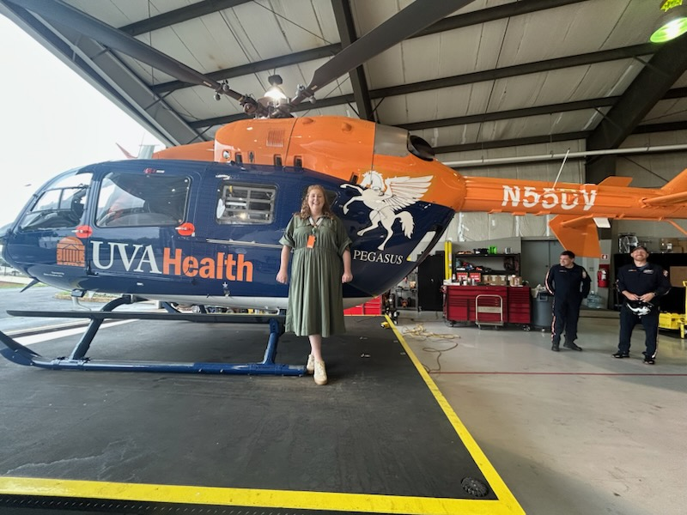

Slide 6
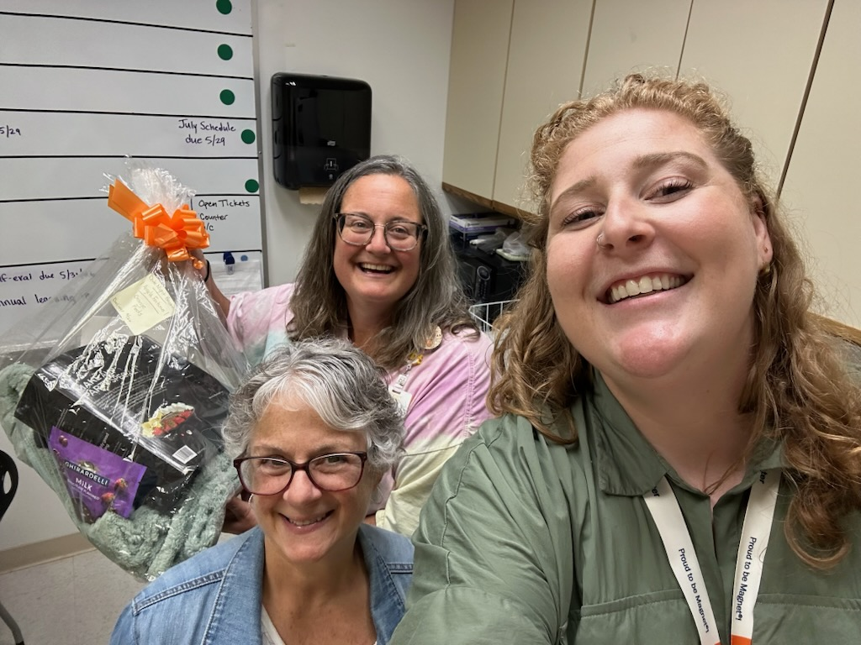

Slide 7
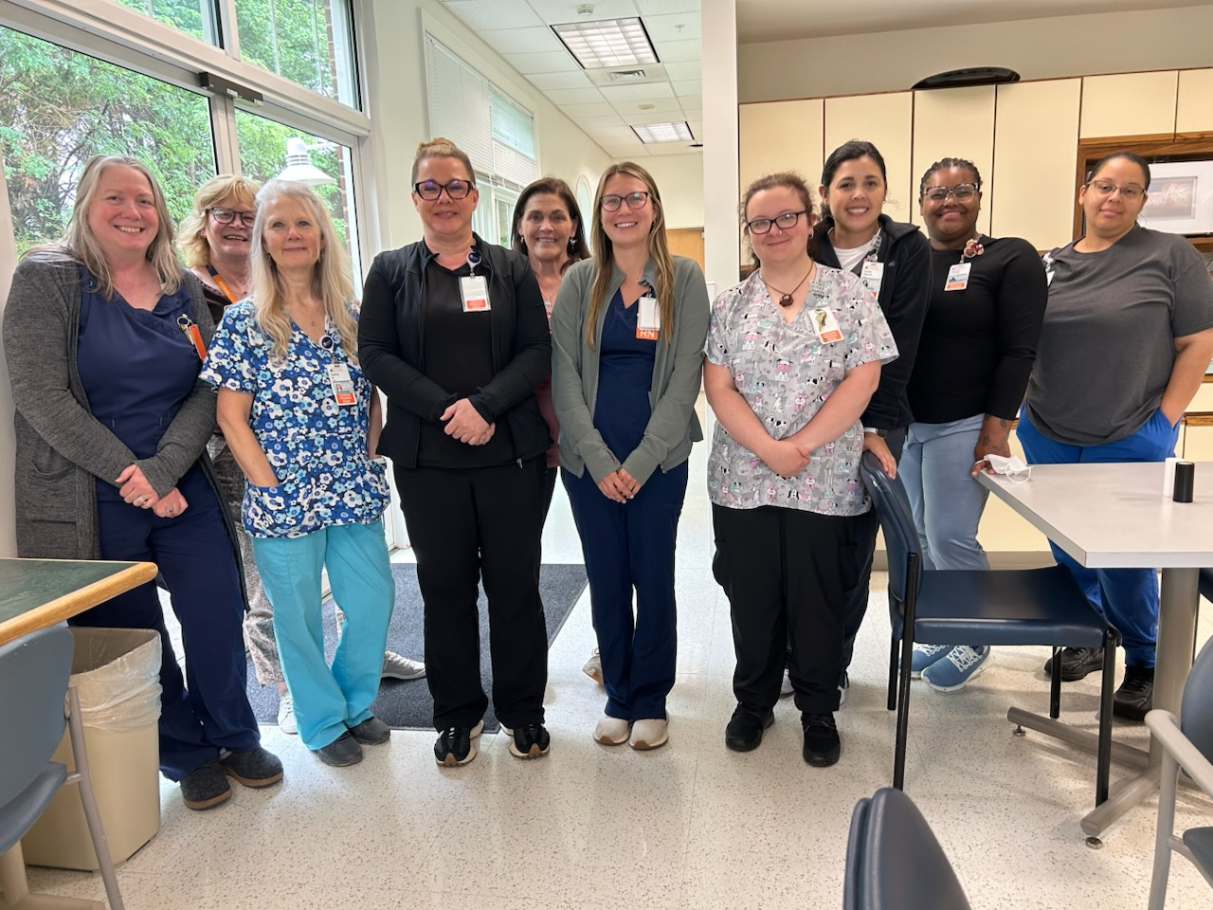

Slide 8
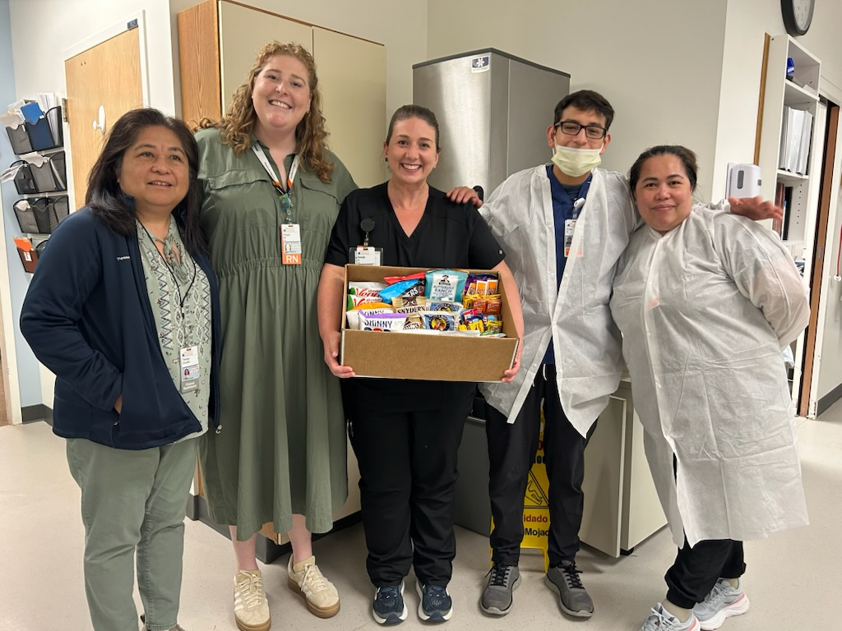

Slide 9
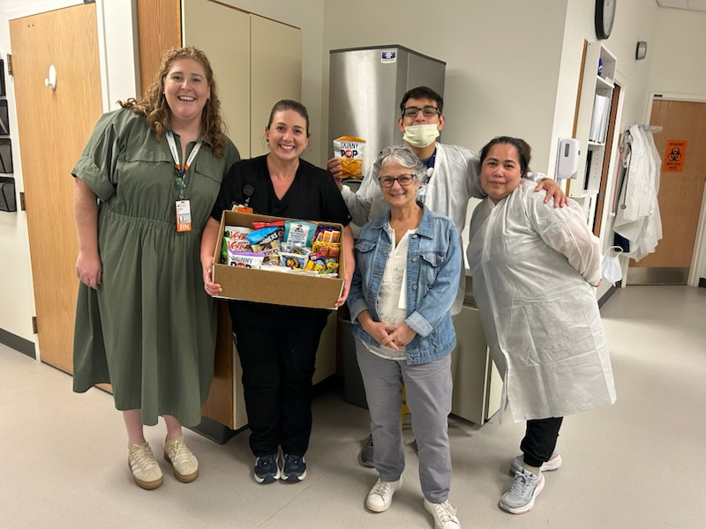

Slide 10
