Slide 1
Bringing the Celebration to You!
Nurses Week 2026
May 20, 2026

Slide 2
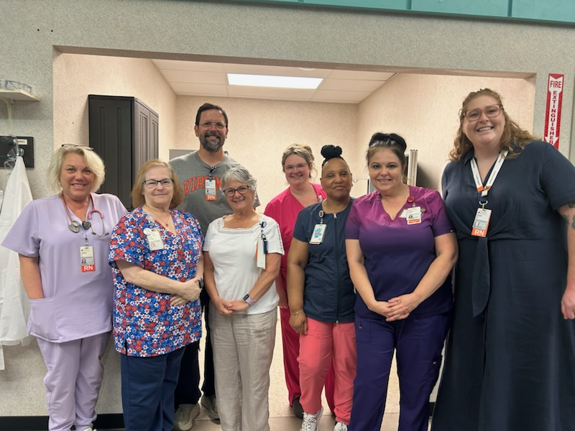

Slide 3
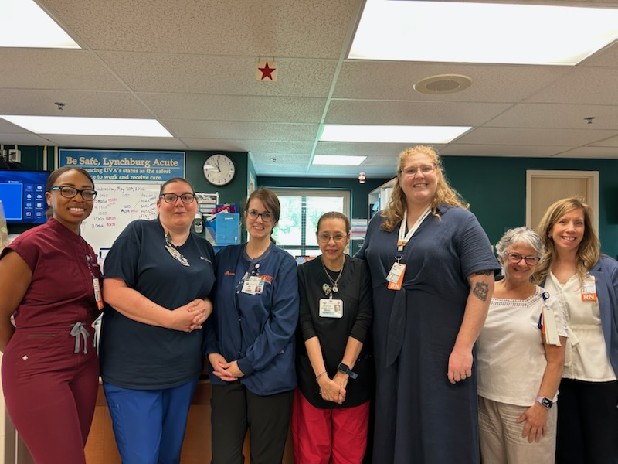

Slide 4
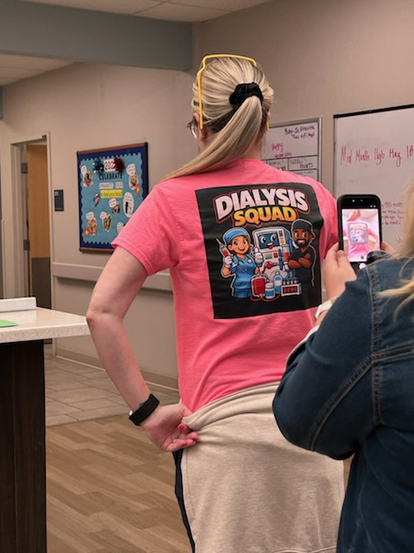

Slide 5
