Slide 1
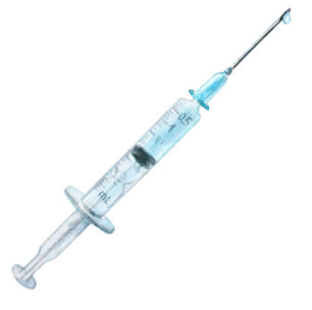

IV LEAGUE AWARD
You Have Been Recognized for YOUR KNACK FOR FINDING VEINS ON THE FIRST TRY, MAKING EVERY IV SEEM LIKE A BREEZE!
Happy Nurses Week! May 6 – 12, 2026
RECIPIENT NAME
Notes:
Note:
This certificate is designed to be printed. You should test print on regular paper to ensure proper positioning before printing on card stock.
You may need to uncheck Scale to Fit Paper in the Print dialog (in the Full Page Slides dropdown).

Slide 2
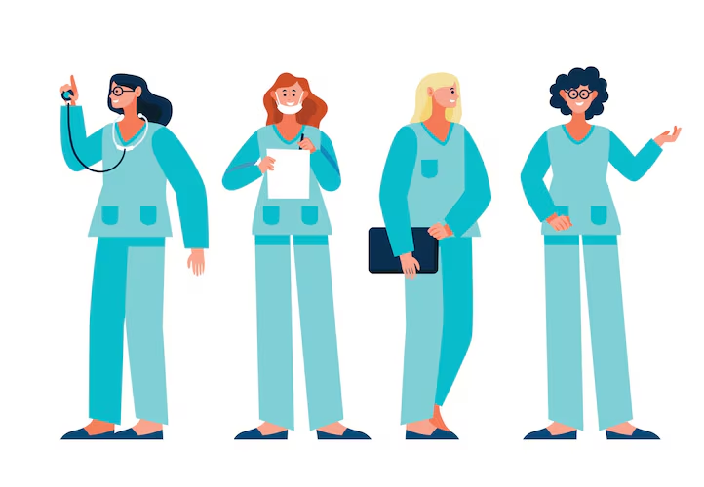
SCRUBS FASHIONISTA AWARD
YOU Have Been Recognized for YOUR FASHION SENSE THAT EXTENDS EVEN TO YOUR WORK ATTIRE, ALWAYS LOOKING STYLISH IN SCRUBS!
Happy Nurses Week! May 6 – 12, 2026
RECIPIENT NAME
Notes:
Note:
This certificate is designed to be printed. You should test print on regular paper to ensure proper positioning before printing on card stock.
You may need to uncheck Scale to Fit Paper in the Print dialog (in the Full Page Slides dropdown).

Slide 3
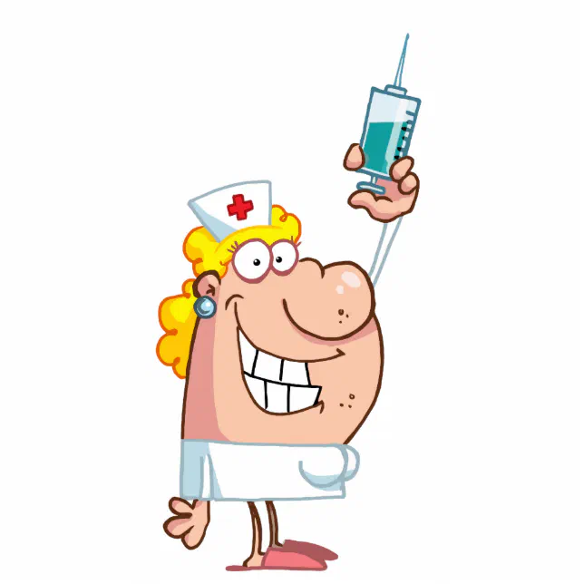
GIGGLE GURU AWARD
YOU have been recognized for YOUR ABILITY TO TURN ANY STRESSFUL SITUATION INTO A GIGGLE FEST WITH YOUR HUMOR!
Happy Nurses Week! May 6 – 12, 2026
RECIPIENT NAME
Notes:
Note:
This certificate is designed to be printed. You should test print on regular paper to ensure proper positioning before printing on card stock.
You may need to uncheck Scale to Fit Paper in the Print dialog (in the Full Page Slides dropdown).

Slide 4
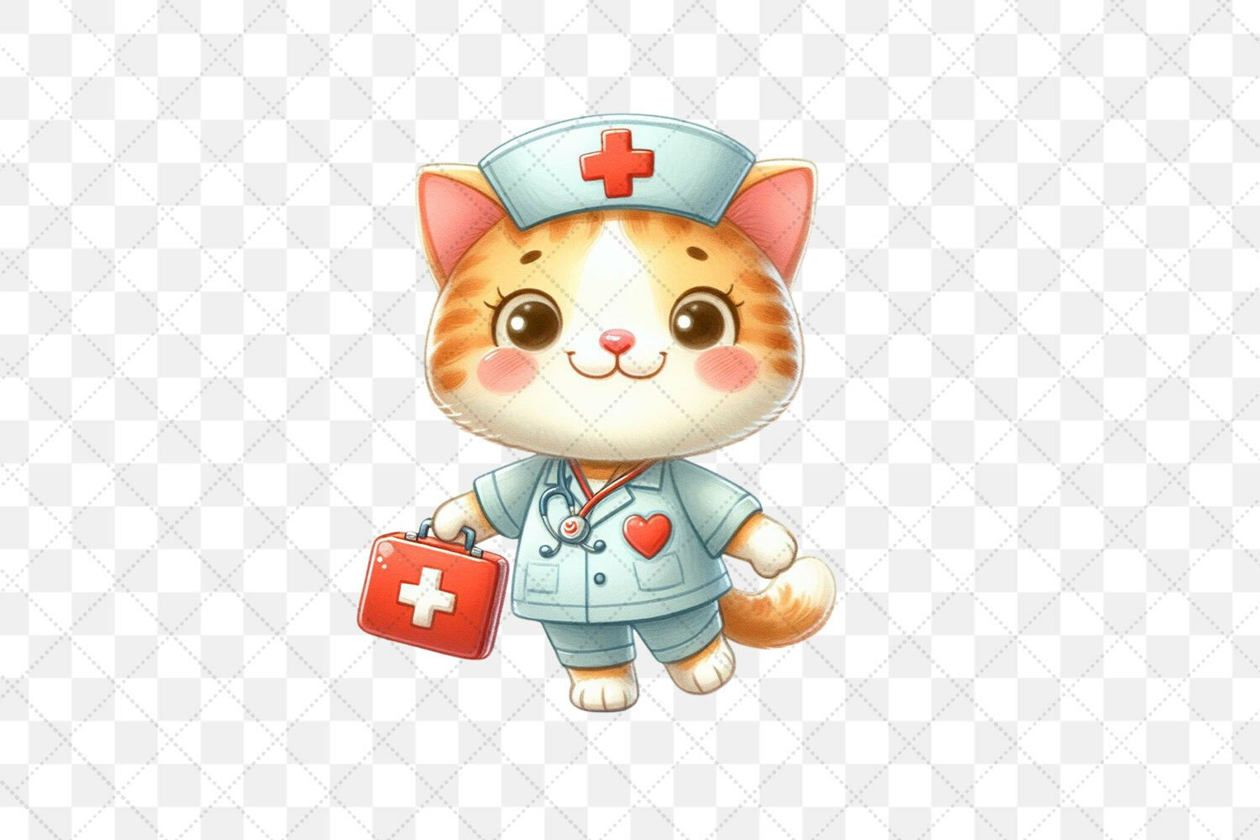
CHAOS MAGNET AWARD
You HAVE BEEN RECOGNIZED FOR YOUR ABILITY TO ATTRACT CHAOS LIKE A MAGNET, YET CAN BRING ORDER WITH YOUR INCREDIBLE SKILLS!
Happy Nurses Week! May 6 – 12, 2026
RECIPIENT NAME
Notes:
Note:
This certificate is designed to be printed. You should test print on regular paper to ensure proper positioning before printing on card stock.
You may need to uncheck Scale to Fit Paper in the Print dialog (in the Full Page Slides dropdown).

Slide 5

YODA AWARD
You have been recognized for BEING THE “GO TO” PERSON WHO SEEMS TO KNOW EVERY POLICY, PROCEDURE, OR FACT!
Happy Nurses Week! May 6 – 12, 2026
RECIPIENT NAME
Notes:
Note:
This certificate is designed to be printed. You should test print on regular paper to ensure proper positioning before printing on card stock.
You may need to uncheck Scale to Fit Paper in the Print dialog (in the Full Page Slides dropdown).

Slide 6
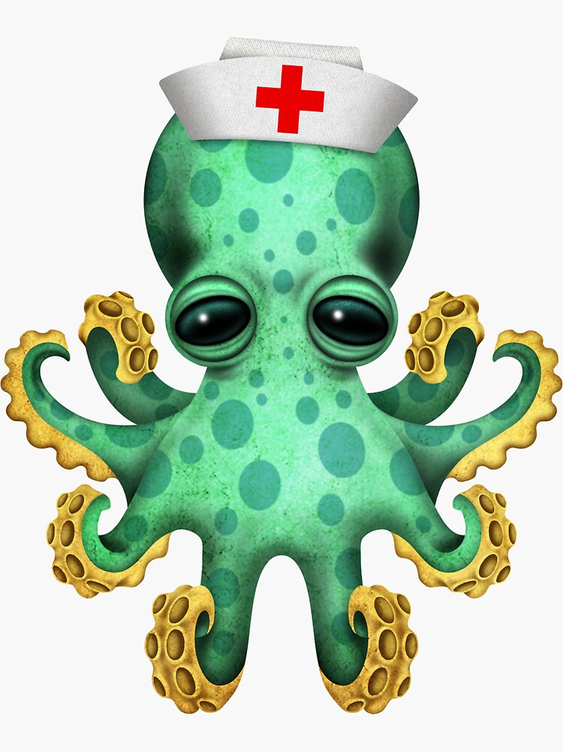
OCTO-NURSE EXTRAORDINAIRE AWARD
You have been recognized YOUR ABILITY TO MULTI-TASK LIKE YOU HAVE EIGHT ARMS, HANDLING NUMEROUS PATIENTS AND/OR TASKS SIMULTANEOUSLY!
Happy Nurses Week! May 6 – 12, 2026
RECIPIENT NAME
Notes:
Note:
This certificate is designed to be printed. You should test print on regular paper to ensure proper positioning before printing on card stock.
You may need to uncheck Scale to Fit Paper in the Print dialog (in the Full Page Slides dropdown).

Slide 7

BUSY BEE AWARD
YOU HAVE BEEN RECOGNIZED FOR YOUR KNACK TO BUZZ AROUND WITH BOUNDLESS ENERGY THAT IS SIMPLY CONTAGIOUS!
Happy Nurses Week! May 6 – 12, 2026
RECIPIENT NAME
Notes:
Note:
This certificate is designed to be printed. You should test print on regular paper to ensure proper positioning before printing on card stock.
You may need to uncheck Scale to Fit Paper in the Print dialog (in the Full Page Slides dropdown).

Slide 8

HEAD CHEERLEADER AWARD
You have been recognized for ALWAYS CHEERING ON THE TEAM TO COMPLETE CERTIFICATIONS, SCHOOL, AND NEW SKILLS!
Happy Nurses Week! May 6 – 12, 2026
RECIPIENT NAME
Notes:
Note:
This certificate is designed to be printed. You should test print on regular paper to ensure proper positioning before printing on card stock.
You may need to uncheck Scale to Fit Paper in the Print dialog (in the Full Page Slides dropdown).

Slide 9

COMPUTER WHIZ AWARD
You have been recognized FOR GIVING GOOD DOCUMENTATION TIPS AND KNOWING HOW TO SORT THROUGH TECH TROUBLES!
Happy Nurses Week! May 6 – 12, 2026
RECIPIENT NAME
Notes:
Note:
This certificate is designed to be printed. You should test print on regular paper to ensure proper positioning before printing on card stock.
You may need to uncheck Scale to Fit Paper in the Print dialog (in the Full Page Slides dropdown).

Slide 10

BETTY CROCKER AWARD
You have been recognized AS THE ONE WHO COOKS/BAKES AND BRINGS IN FOOD TO SHARE REGUARLY!
Happy Nurses Week! May 6 – 12, 2026
RECIPIENT NAME
Notes:
Note:
This certificate is designed to be printed. You should test print on regular paper to ensure proper positioning before printing on card stock.
You may need to uncheck Scale to Fit Paper in the Print dialog (in the Full Page Slides dropdown).

Slide 11

PARTY ANIMAL AWARD
You have been recognized as THE MOST LIKELY TO PLAN THE NEXT TEAM GATHERING!
Happy Nurses Week! May 6 – 12, 2026
RECIPIENT NAME
Notes:
Note:
This certificate is designed to be printed. You should test print on regular paper to ensure proper positioning before printing on card stock.
You may need to uncheck Scale to Fit Paper in the Print dialog (in the Full Page Slides dropdown).

Slide 12

QUICK FEET AWARD
YOU HAVE BEEN RECOGNIZED AS ALWAYS BEING THE FIRST PERSON IN THE ROOM IN AN EMERGENCY!
Happy Nurses Week! May 6 – 12, 2026
RECIPIENT NAME
Notes:
Note:
This certificate is designed to be printed. You should test print on regular paper to ensure proper positioning before printing on card stock.
You may need to uncheck Scale to Fit Paper in the Print dialog (in the Full Page Slides dropdown).

Slide 13

CHAMPAGNE AWARD
YOU HAVE BEEN RECOGNIZED FOR HAVING THE MOST SPARKING PERSONALITY!
Happy Nurses Week! May 6 – 12, 2026
RECIPIENT NAME
Notes:
Note:
This certificate is designed to be printed. You should test print on regular paper to ensure proper positioning before printing on card stock.
You may need to uncheck Scale to Fit Paper in the Print dialog (in the Full Page Slides dropdown).

Slide 14


MR. CLEAN AWARD
YOU HAVE BEEN RECOGNIZED AS THE team member that keeps our work area the cleanest/tidiest!
Happy Nurses Week! May 6 – 12, 2026
RECIPIENT NAME
Notes:
Note:
This certificate is designed to be printed. You should test print on regular paper to ensure proper positioning before printing on card stock.
You may need to uncheck Scale to Fit Paper in the Print dialog (in the Full Page Slides dropdown).

Slide 15

SUNSHINE AWARD
You have been recognized FOR ALWAYS KEEPING A POSITIVE ATTITUDE!
Happy Nurses Week! May 6 – 12, 2026
RECIPIENT NAME
Notes:
Note:
This certificate is designed to be printed. You should test print on regular paper to ensure proper positioning before printing on card stock.
You may need to uncheck Scale to Fit Paper in the Print dialog (in the Full Page Slides dropdown).

