Slide 1

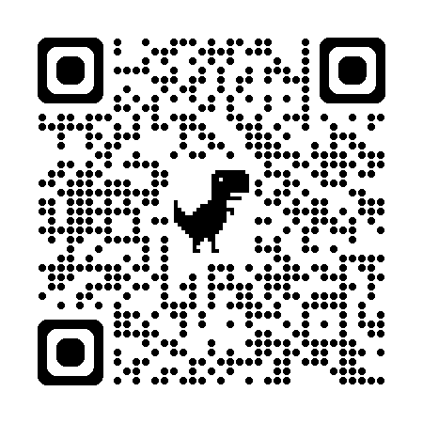

Magnet Minute
ANCC Magnet Recognition® is an honor reserved for organizations that demonstrate commitment to transformational leadership, structural empowerment, exemplary professional practice, and new knowledge and innovation. As a Magnet-recognized organization, UVA Health University Medical Center nurses achieve excellence in these areas by leveraging our Nursing Care Delivery Model of Relationship-Based Care, shown at the center of our Professional Practice Model.
EP1EOa
Provide one example of an improved outcome associated with an evidence-based change made by clinical nurses in alignment with the organization’s professional practice model.
Notes:
Magnet Recognition® is an honor reserved for organizations that demonstrate commitment to transformational leadership, structural empowerment, exemplary professional practice, and new knowledge and innovation. As a Magnet-recognized organization, UVA Health University Medical Center nurses achieve excellence in these areas by leveraging our Nursing Care Delivery Model of Relationship-Based Care, shown here at the center of our Professional Practice Model.
This Magnet Moment is for the EP1EOa standard, which requires the following: Provide one example of an improved outcome associated with an evidence-based change made by clinical nurses in alignment with the organization’s professional practice model.

Slide 2

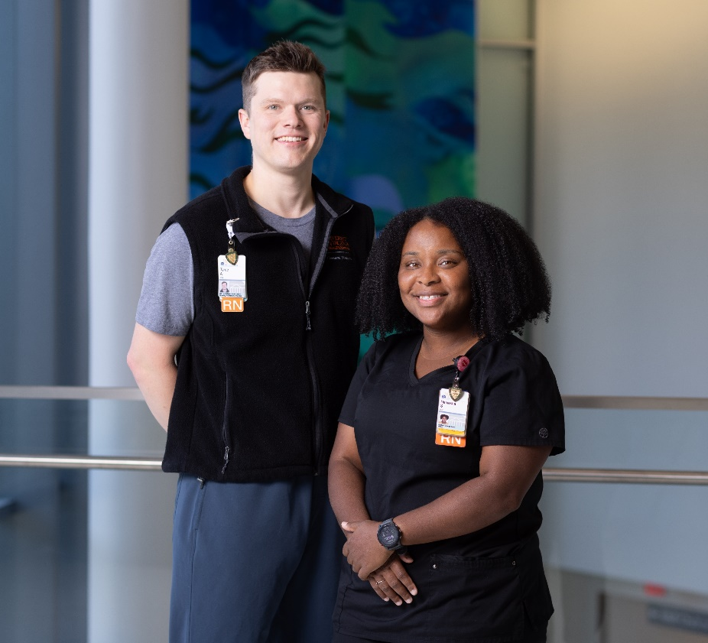
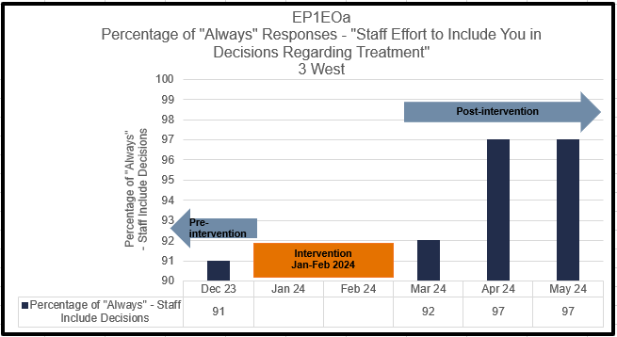
Magnet Minute
Patient Experience Improvement on 3 West
Inpatient Charge Nurse and Patient Experience Champion, Daniesha Shelton, and Unit Based Nurse Leader Ty Ashworth sought to improve the patient experience on 3 West, and focused on the question “Staff Effort to Include You in Decisions Regarding Treatment”. Daniesha and Ty connected with Anita Orr from Patient Experience and explored the Agency for Healthcare Research and Quality (AHRQ) resource for evidence-based solutions.
Daniesha and Ty followed the AHRQ strategy involving bedside shift reports that actively engage patients and families to improve patient experience. They led the 3 West team to implement bedside handoff-of-care within the 1st hour of each shift, including asking the patient “What are your current goals & concerns?” and updated the visual management board when completed. They were successful in improving the patient experience.
Notes:
Daniesha Shelton, Inpatient Charge Nurse and 3 West Patient Experience Champion, and Ty Ashworth, Unit Based Nurse Leader, evaluated organizational goals and sought to improve the patient experience on 3 west, focusing specifically on the question “Staff Effort to Include You in Decisions Regarding Treatment”. They reached out to Anita Orr with the Patient Experience office and explored evidence-based resources through the Agency for Healthcare Research and Quality (AHRQ) to find possible solutions. A strategy recommended by AHRQ involves conducting bedside shift reports, which includes active engagement of patients and families, as they are essential partners in the healthcare team. Daniesha and Ty followed the AHRQ strategy involving bedside shift reports and led the 3 West team to implement bedside handoff-of-care. The intervention began on January 1, 2024 and included nurses performing bedside handoff-of-care within the first hour of the shift and asked each patient the question “What are you current goals and concerns?” and updated the visual management board as either “completed” “completed after 1 hour” or “not completed”. Throughout the implementation phase, Ty collected data from the visual management board and conducted one-on-one interviews with clinical staff, discussing barriers and also prompting them with the question, “can you tell me what went well?”.
Daniesha and Ty discovered that these one-on-one interviews were incredibly informative, complementing the knowledge gained from morning huddles and staff meetings. Additionally, they were able to use the data collected to show the nursing team the tangible impact of the intervention.
The evidence-based bedside handoff-of-care intervention aimed at increasing patients’ feelings that staff included them in decisions regarding their treatment had a profound impact on 3 West. By allowing patients to participate actively in their own care, it raised a sense of ownership and collaboration between the 3 West nurses and patients. This partnership improved patient satisfaction, which led to more informed decision making processes. Patients felt involved in their treatment decisions and ultimately, their patient experience improved. The percentage of “Always” Responses for “Staff Effort to Include You in Decisions Regarding Treatment” reached 97 percent.

