Slide 1
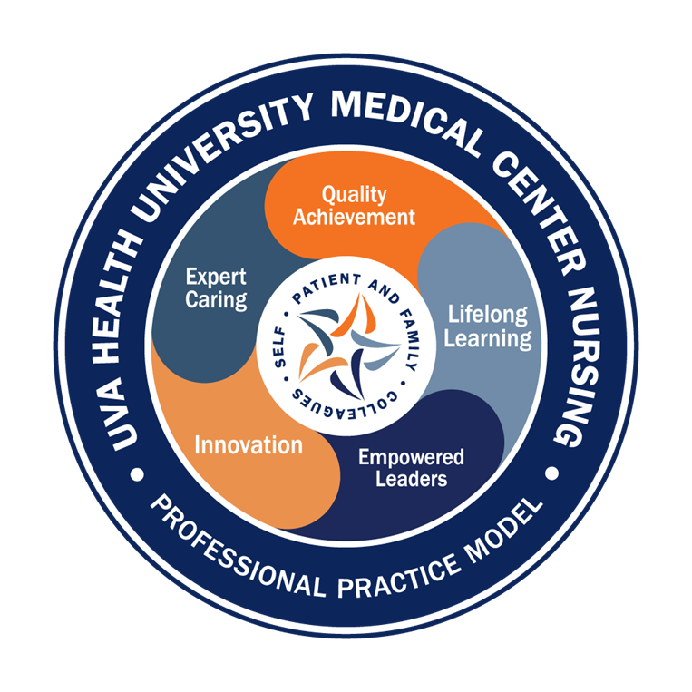
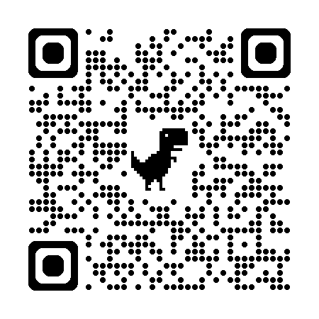

Magnet Minute
ANCC Magnet Recognition® is an honor reserved for organizations that demonstrate commitment to transformational leadership, structural empowerment, exemplary professional practice, and new knowledge and innovation. As a Magnet-recognized organization, UVA Health University Medical Center nurses achieve excellence in these areas by leveraging our Nursing Care Delivery Model of Relationship-Based Care, shown at the center of our Professional Practice Model.
NK5b
Provide one example, with supporting evidence, of how a clinical nurse(s) implemented an evidence-based practice that is new or a revision to existing practice in an ambulatory care setting within the organization.
Notes:
Magnet Recognition® is an honor reserved for organizations that demonstrate commitment to transformational leadership, structural empowerment, exemplary professional practice, and new knowledge and innovation. As a Magnet-recognized organization, UVA Health University Medical Center nurses achieve excellence in these areas by leveraging our Nursing Care Delivery Model of Relationship-Based Care, shown here at the center of our Professional Practice Model.
This Magnet Moment is for the NK5b standard, which requires the following: Provide one example, with supporting evidence, of how a clinical nurse(s) implemented an evidence-based practice that is new or a revision to existing practice in an ambulatory care setting within the organization.

Slide 2

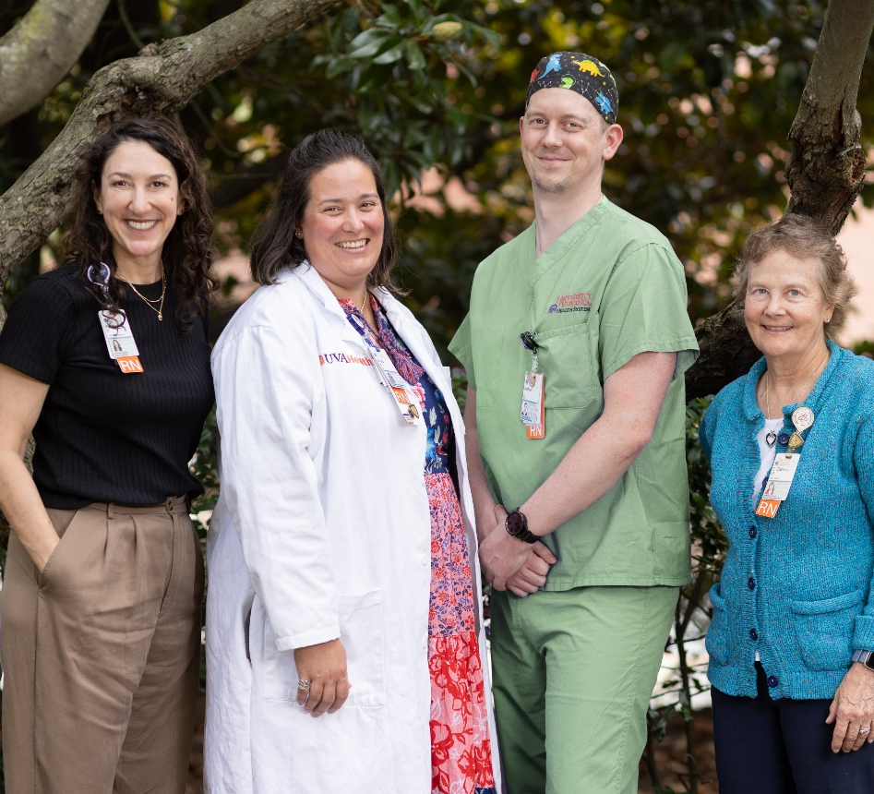
Magnet Minute
mRASS: Improving Sedation Assessment
Clinician 4 Danita Massie attended the Association for Radiologic & Imaging Nursing and the Society of Interventional Radiology (ARIN/SIR) conference in March 2023, where she discovered opportunity to question which nurse-sensitive outcomes existed in her practice area in Interventional Radiology. After the conference, Danita collaborated with her peers and identified a lack of nurse sedation assessment tools for patients undergoing moderate sedation in IR procedures. This led to difficulty precepting new nurses to IR, a lack of historical patient data on sedation experiences, and no common language to guide physicians and nurses when developing a sedation plan.
Danita worked with her peer, Clinician 2 Matthew Lease, and RN Research Coordinator Claiborne Miller-Davis. Together, they completed a literature review and comprehensive synthesis and determined that the mRASS tool would best meet their needs to test as a sedation measurement tool.
Danita, Matthew and Claiborne updated the pertinent interdisciplinary stakeholders for support and worked to have the mRASS tool incorporated into Epic, along with educational in-services to teach IR nurses and providers. In July 2024, mRASS was implemented in IR as a pilot tool for nurses to use during sedation procedures.
Notes:
In March 2023, Clinician 4 Danita Massie attended a radiology conference and asked other procedure nurses what metrics they were utilizing and tracking to improve their patient care. She received the same answer that reflected her current practice, of tracking room times and caseloads; however, most other outcomes were primarily physician- and not nursing-driven. This caused Danita to consider: What do the nurses in my practice own, and how can we measure it and track it to improve patient outcomes?
Danita collaborated with her peers to determine what areas of their nursing practice had opportunity for improvement. They realized in IR, nurse-provided moderate sedation is a common and critical procedure with a fairly high risk to patient safety, yet there was a lack of nurse sedation assessment tools for patients undergoing moderate sedation in IR procedures. Danita and her team determined the following issues occurred when patients were under nurse moderate sedation in IR:
• a Lack of sedation assessment tool
• Difficulty precepting new nurses into the practice setting, as there was no formal guideline and language to guide their training
• No available data from a patient’s previous sedation experience to help make future decisions for sedation plans moving forward
• No common language to guide the physicians and nurses when developing the sedation plan
The team recognized that if these issues were not addressed, the patients and team were at risk of not meeting patient needs for sedation management.
Danita worked with RN Research Coordinator Claiborne Miller-Davis and her IR colleague, Clinician 2 Matthew Lease, and found that a search of background literature showed a significant gap in this area of nursing literature and research around metrics for measuring sedation. Most of the work targeted timing and efficiency for procedural areas (focused on patient flow and processes); however, very little existed on what nursing metrics should be measured. The background search looking for potential tools for sedation showed good literature evidence for several tools, such as the Richmond Agitation-Sedation Scale (RASS) and the Ramsay Sedation Scale. The literature review determined that both the RASS and Ramsey sedation scales were valid and reliable. RASS was already utilized in the ICUs at UVA, which created a foundation of general familiarity with the tool. Additionally, the RASS had a current build within EPIC, and was able to measure agitation, which can be a key component during procedural sedation. The literature search was narrowed to RASS. RASS was originally developed around delirium and in the ICUs, so it included language around intubated patients. Work out of Harvard proposed a Modified RASS (mRASS) assessment, which removed the language around intubated patients and slightly modified the language to fit an outpatient setting. From the literature review, it was determined that mRASS would be the best fit for IR, as they monitor sedation for noncritical, ambulatory care patients. Updates were presented to various stakeholders, and the team received support from all of the necessary nursing and interdisciplinary committees. From April to June 2024, Danita and Matthew worked to have the mRASS tool incorporated into EPIC. Educational in-services took place to teach the tool to IR nurses and providers in May and June 2024. In July 2024, mRASS was implemented in IR as a pilot tool for nurses to utilize during sedation procedures.
Please join us in congratulating Danita, Claiborne, Matthew and the entire IR team for their work on this initiative!
This Magnet minute is just a small representation of an enormous amount of work that occurred. To read the full Magnet story that was submitted as part of our Magnet document, scan the QR code pictured on this slide, or search for the story in our Magnet Document website.

