Slide 1



Magnet Minute
ANCC Magnet Recognition® is an honor reserved for organizations that demonstrate commitment to transformational leadership, structural empowerment, exemplary professional practice, and new knowledge and innovation. As a Magnet-recognized organization, UVA Health University Medical Center nurses achieve excellence in these areas by leveraging our Nursing Care Delivery Model of Relationship-Based Care, shown at the center of our Professional Practice Model.
SE2EOb
Provide one example of an improved outcome associated with the application of nursing standards of practice implemented due to a clinical nurse’s(s’) participation in a nursing professional organization.
Notes:
Magnet Recognition® is an honor reserved for organizations that demonstrate commitment to transformational leadership, structural empowerment, exemplary professional practice, and new knowledge and innovation. As a Magnet-recognized organization, UVA Health University Medical Center nurses achieve excellence in these areas by leveraging our Nursing Care Delivery Model of Relationship-Based Care, shown here at the center of our Professional Practice Model.
This Magnet Moment is for the SE2EOb standard, which requires the following: Provide one example of an improved outcome associated with the application of nursing standards of practice implemented due to a clinical nurse’s participation in a nursing professional organization.

Slide 2


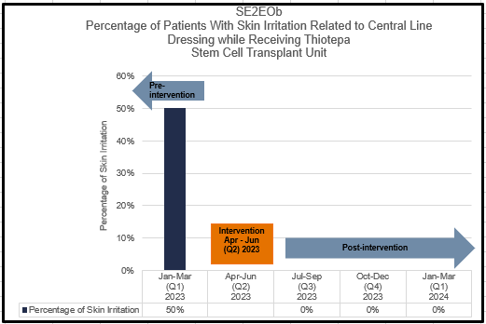
Magnet Minute
Improving Thiotepa-Related Skin Irritation in the SCTU
Clinical Nurse Specialist, Tanya Thomas, is an actively participating member of the Oncology Nursing Society (ONS), and has led or supported development of patient education content, review of EBP recommendations, and developed guidelines for extravasation. Tanya leveraged her connections to ONS to seek guidance on management of skin care for patients receiving Thiotepa in the SCTU. Thiotepa is primarily excreted through the skin and can cause irritation. For this work, she collaborated with Paula Edwards, Clinician 3 and Paul Yoder, Clinician 4.
Tanya, Paula and Paul learned that patients in the SCTU were showering more frequently than necessary with complete linen and dressing changes after each shower. Additionally, they discovered that central line dressings for patients receiving Thiotepa were not standard and the amount of skin covered varied. Together, they revised the Standard Operating Procedure for care of these patients, including changing the frequency of showering and a standardized process for central line dressings. They also updated relevant patient education and trained the SCTU team on the nursing practice revisions.
Notes:
A subset of patients in the Stem Cell Transplant Unit (SCTU) receive a chemotherapy agent named Thiotepa, most often used in this setting as a conditioning agent to prepare for transplant. Thiotepa is excreted through the skin as sweat. Skin toxicity can occur from high concentrations of Thiotepa on the skin, especially in the groin, axillae, skin folds, in the neck area and under dressings. It can cause severe skin irritation, which can worsen with increased frequency of dressing changes and cleaning of central line insertion sites. Patients receiving Thiotepa must take frequent showers, change anything that has come in contact with their skin after showering, cannot use the standard dressing applied to central lines, and must avoid perfumes and lotions. The nursing standard of practice in the SCTU was for patients to shower every six hours, with linen and dressing changes after the shower. Everything that touched the patient’s skin was changed, including their identification wristband. However, patients receiving Thiotepa in the SCTU were experiencing skin irritation around the dressing site with frequent central line dressing changes and hygienic care. Additionally, the dressings used for central lines for these patients were not standard, and there was variation in the amount of skin that the dressing covered.
Clinical Nurse Specialist Tanya Thomas is an actively participating member of the Oncology Nursing Society (ONS). She has led or supported the development of patient education content, review of evidence-based practice recommendations, and developed guidelines for ONS related to extravasation. Tanya also serves as the clinical lead for the ONS and American Society of Clinical Oncology Extravasation Management Guideline, which will be the first guideline providing guidance related to all aspects of antineoplastic extravasation management. Tanya became concerned when she noted that 50% of patients receiving Thiotepa in the SCTU were experiencing skin irritation around their central line dressing site. She was able to leverage her connections to ONS to seek guidance on the management of skin care for patients receiving Thiotepa. Tanya collaborated with Clinician 3 Paula Edwards and Clinician 4 Paul Yoder. Together, they learned that patients in the SCTU were showering more frequently than necessary, every 6 hours, with complete linen and dressing changes after the shower. They also discovered that central line dressings for patients receiving Thiotepa were not standard within the transplant community, and the amount of skin covered varied. With the information learned from ONS resources and colleagues, the clinical nurses identified opportunities to improve nursing practice in the care of patients receiving Thiotepa. Tanya, Paula and Paul revised the Standard Operating Procedure for care of these patients, including changing the frequency of showering and a standardized process for central line dressings. They also updated relevant patient education and trained the SCTU team on the nursing practice revisions.
As a result of their efforts, no patients experienced skin irritation related to their central line dressing while receiving Thiotepa after the changes.

