Slide 1
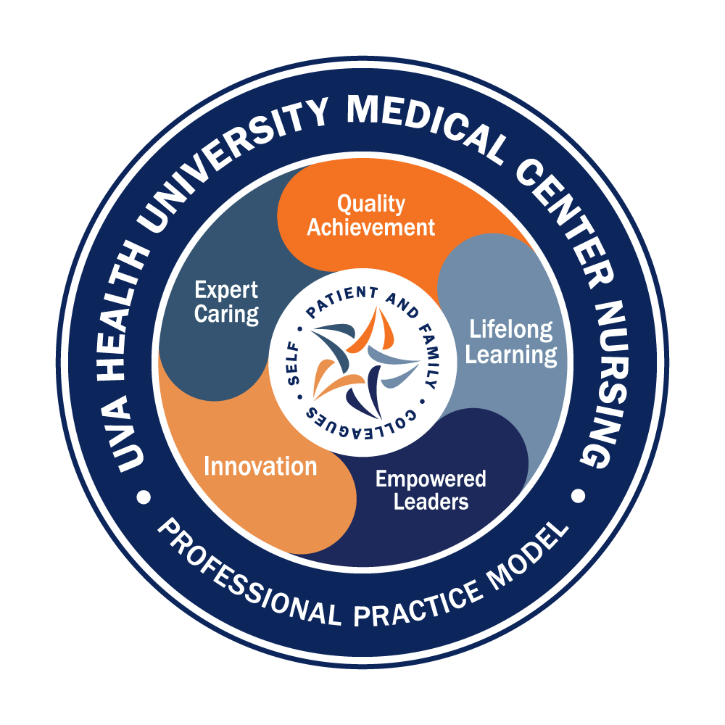
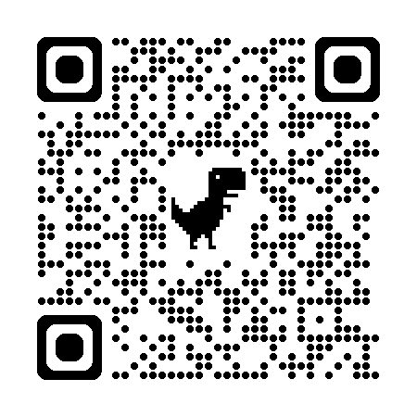

Magnet Minute
ANCC Magnet Recognition® is an honor reserved for organizations that demonstrate commitment to transformational leadership, structural empowerment, exemplary professional practice, and new knowledge and innovation. As a Magnet-recognized organization, UVA Health University Medical Center nurses achieve excellence in these areas by leveraging our Nursing Care Delivery Model of Relationship-Based Care, shown at the center of our Professional Practice Model.
SE5/SE6EO
Provide a narrative description of a unit’s or division’s action plan for registered nurses’ progress toward obtaining professional board certification. Provide graphed data (displayed as a percentage) of baseline data, plus two years of data, demonstrating nursing has met or exceeded a targeted goal at the unit or division level, for improvement in professional board certification.
Notes:
Magnet Recognition® is an honor reserved for organizations that demonstrate commitment to transformational leadership, structural empowerment, exemplary professional practice, and new knowledge and innovation. As a Magnet-recognized organization, UVA Health University Medical Center nurses achieve excellence in these areas by leveraging our Nursing Care Delivery Model of Relationship-Based Care, shown here at the center of our Professional Practice Model.
This Magnet Minute is for the SE5 and SE6EO standards which require the following: Provide a narrative description of a unit’s or division’s action plan for registered nurses’ progress toward obtaining professional board certification, and, provide graphed data (displayed as a percentage) of baseline data, plus two years of data, demonstrating nursing has met or exceeded a targeted goal at the unit or division level, for improvement in professional board certification.

Slide 2

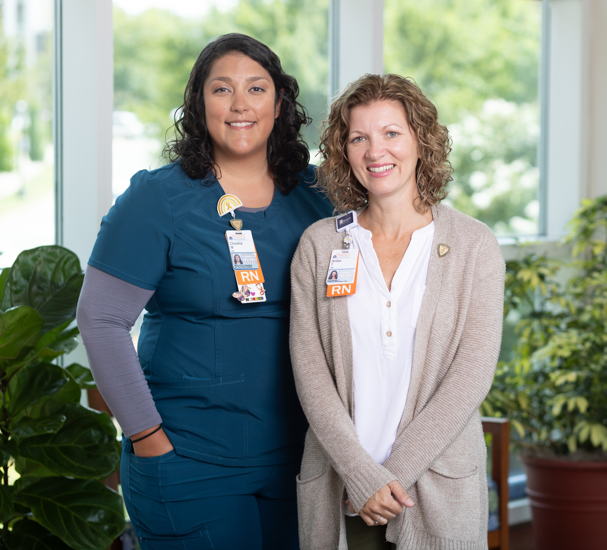
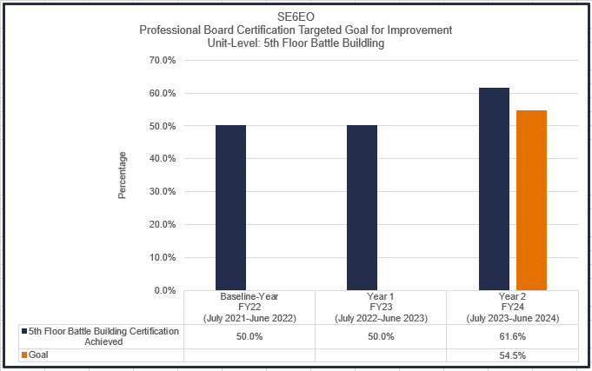
Magnet Minute
5th Floor Battle Building Certification
The 5th Floor Battle Building’s nursing professional governance committee reviews the team’s certification rate each year and establishes a goal for the upcoming year. To analyze their most recent rate, Clinician 3 and Certification Champion Christina Mlinarchik-Gutierrez partnered closely with the Nurse Manager, Amber Tyson, to run the certification report in Workday. Additionally, Amber supported Christina to attend a Certification Bootcamp and other professional governance meetings to gain knowledge of resources.
In addition to Christina’s expertise as a Certification Champion, Amber helped support the team to meet their certification goal by encouraging professional development goal setting and coaching to Clinical Career Ladder requirements. Christina and Amber used a variety of communication methods to share available resources with the team. Through a team “Certification Library”, one-on-one coaching, and group study sessions, the team was successful in meeting their 2-year goal.
Notes:
The 5th Floor Battle Building’s nursing professional governance committee reviews the team’s certification rate each year, and then establishes a goal for the upcoming year. To analyze their certification rate, the team’s certification champion partners closely with the Ambulatory Clinic Nurse Manager, Amber Tyson, to run the department’s certification report in Workday. The champion uses the job aid available on the certification resource website to calculate their current rate and consider a potential goal for the upcoming year. The champion proposes a recommended certification goal to the governance committee, which is then discussed and approved. At the end of Fiscal Year (FY) 2022, the committee reviewed their data, and saw that they had a 50% professional board certification rate. In discussing a goal for the next year, the team considered the changes to their team that they were experiencing and expecting as they moved out of the height of the pandemic, including: retirements, additional hires to support the department’s growth, and nurses becoming eligible to take the certification exam. Considering this information and recognizing the expected growth within their department, the committee established a two-year certification goal of 54.5% for FY23-24. This provided them with the flexibility to grow and develop their team through the changes they were expecting while continuing to build a culture of certification as a team priority.
The 5th Floor Battle Building team, led by Amber, leveraged a number of strategies to achieve their professional board certification goal. A big component of the team’s success in promoting certification included having a certification champion. Amber supported the champion model in alignment with their nursing professional governance committee, which provided local expertise and passion regarding certifications relevant to their patient population. Clinician 3 Christina Mlinarchik-Gutierrez stepped up to be the certification champion in FY23. Christina was supported to attend certification champion boot camps and other meetings to enhance her knowledge of organizational resources and to create strategies to assist her team in meeting their goal. She was supported with time to attend these sessions, as well as time to participate in their local professional governance meetings and engage in champion activities, such as team communications, individual coaching and tracking the team’s progress.
Another important activity to aid the success of the team was professional development goal setting. To support career growth and professional development, Amber guided her clinical nurses to use their annual professional development goal setting to document their plan to achieve professional board certification. This goal setting is a part of the performance appraisal process related to professional development. Additionally, Professional board certification is required for Clinician 3 and 4 levels on the Clinical Career Ladder. Amber promoted professional development and career growth for her nursing team, coaching her team to achieve and maintain certification to prepare for advancement on the Clinical Career Ladder to recognize their clinical expertise and leadership skills.
Finally, an annual bonus is provided to all certified nurses, paid in March, as part of National Certified Nurses’ Day celebrations. Christina promoted this frequently and broadly each year to her team as a motivator to become certified or maintain certification.
Amber and Christina leveraged a variety of mechanisms of support to the team to achieve their professional board certification goal, and communicated through regular emails to the team, posters in the department, and presentations at team and local professional governance meetings to provide updates on their certification goal, upcoming important dates – such as the annual bonus deadline, and information about resources to support their certification achievement or re-certification process. With approval from her manager, Christina reached out to the UVA Bookstore to order a number of review books and study materials to create a Certification Library pertinent to their team’s most frequently held certifications. Christina routinely provided one-on-one coaching to her nursing colleagues. She proactively reached out to nurses who were eligible to become certified or who wanted to become certified, shared with them steps to take, the funding resources and review materials available to them, and helped answer any questions they might have. As an idea she heard from a fellow certification champion, Christina offered group study sessions to help support the team and to decrease the anxiety around taking the exam.
At the completion of FY24, Christina calculated their certification rate as 61.6%, and the 5th Floor Battle Building team celebrated exceeding their two-year professional board certification goal.

