Slide 1
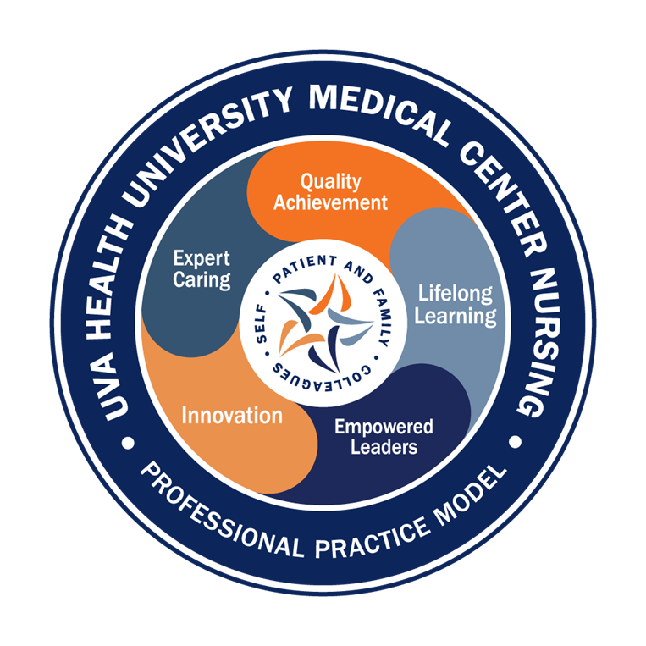


Magnet Minute
ANCC Magnet Recognition® is an honor reserved for organizations that demonstrate commitment to transformational leadership, structural empowerment, exemplary professional practice, and new knowledge and innovation. As a Magnet-recognized organization, UVA Health University Medical Center nurses achieve excellence in these areas by leveraging our Nursing Care Delivery Model of Relationship-Based Care, shown at the center of our Professional Practice Model.
TL11EO
Provide one example of an improved outcome where a clinical nurse(s) used data to advocate for the acquisition of a resource, in support of the care delivery system(s).
Notes:
Magnet Recognition® is an honor reserved for organizations that demonstrate commitment to transformational leadership, structural empowerment, exemplary professional practice, and new knowledge and innovation. As a Magnet-recognized organization, UVA Health University Medical Center nurses achieve excellence in these areas by leveraging our Nursing Care Delivery Model of Relationship-Based Care, shown here at the center of our Professional Practice Model.
This Magnet Minute is for the TL11EO standard, which requires the following: Provide one example of an improved outcome where a clinical nurse(s) used data to advocate for the acquisition of a resource, in support of the care delivery system(s).

Slide 2

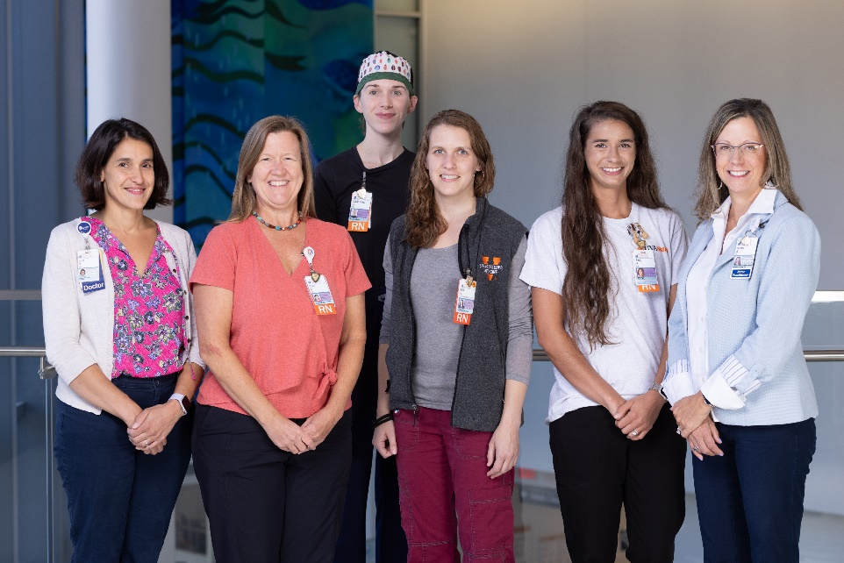
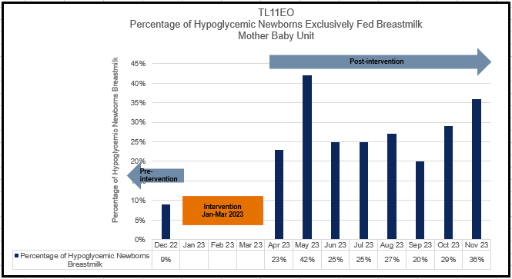
Magnet Minute
Hypoglycemic Newborns Exclusively Fed Breastmilk
In 2022, newborn patients experiencing hypoglycemia in the Mother Baby Unit, whose guardians wished for them to be fed breastmilk exclusively, were often required to be fed formula. Erin Golden, Clinician 4, advocated for the use of pasteurized donor human milk (PDHM) as a treatment option in lieu of formula. Erin referenced prior work on this concept completed by Erica Weiler, Clinician 4, and presented financial data showing a projected low cost for the use of PDHM in the Mother Baby Unit’s newborn patient population.
With support from the Newborn Medical Director, Elisa Hampton, Nurse Director Deb Sizemore, and a group of CNL nursing students, Erin led the team to obtain and implement the use of PDHM for hypoglycemic newborns. This included new clinical documents and team education. Erin’s advocacy for PDHM to support the care delivery system for newborns was successful, and a higher percentage of newborns were able to receive breastmilk instead of formula in the setting of hypoglycemia in 2023.
Notes:
At the end of 2022, pasteurized donor human milk, or PDHM, was not available for newborns in the Mother Baby Unit. Newborn patients experiencing hypoglycemia, whose guardians wished for them to be fed breastmilk exclusively, were often required to be fed formula during hypoglycemic episodes. Only 9% of newborns who experienced hypoglycemia were able to receive exclusive breastmilk feeds in the Mother Baby unit, with an additional feed from their mother or with her expressed breastmilk.
Clinician 4 Erin Golden understood the importance PDHM had in supporting newborns to maintain exclusive breastmilk feedings. Erin’s colleague, Clinician 4 Erica Weiler, had previously started on advocacy to incorporate PDHM for newborns on the Mother Baby unit. Building on prior work by Erica, Erin advocated for the addition of PDHM as a treatment option for newborns experiencing hypoglycemia in lieu of formula. She referenced available evidence on the superior outcomes associated with breastmilk, and presented financial data that showed a projected low cost for the use of PDHM. Erin collaborated with Newborn Medical Director Elisa Hampton, who shared Erin’s data with Nurse Director Deb Sizemore. Deb was impressed with the low cost of PDHM and granted approval for the team to proceed with implementation on the Mother Baby Unit.
With Deb’s approval, Erin and Elisa began the implementation process. Erin utilized Erica’s input from prior efforts, and collaborated with a group of CNL nursing students on the unit. They worked on drafts for supporting documents for the use of PDHM, including a new Standard Operating Procedure document and a new Clinical practice Guideline. Additionally, the team provided skills sessions for the Mother Baby team and conducted pre and post implementation surveys to measure staff confidence regarding the new guidelines.
PDHM was available for use on the Mother Baby unit in March 2023. Erin’s advocacy for PDHM to support the care delivery system for newborns in the Mother Baby Unit proved to be successful. She provided data showing a low financial cost to the organization for the use of PDHM, with an improved adherence to evidence-based practice. With Erin’s advocacy, Erica’s expertise, Elisa’s and Deb’s support and the CNL student collaboration for implementation, a higher percentage of newborns were able to receive breastmilk instead of formula in the setting of hypoglycemia.

