Slide 1



Magnet Minute
ANCC Magnet Recognition® is an honor reserved for organizations that demonstrate commitment to transformational leadership, structural empowerment, exemplary professional practice, and new knowledge and innovation. As a Magnet-recognized organization, UVA Health University Medical Center nurses achieve excellence in these areas by leveraging our Nursing Care Delivery Model of Relationship-Based Care, shown at the center of our Professional Practice Model.
TL2
Provide one example of a Nurse Manager’s participation in an initiative which promoted workplace diversity, equity, and/or inclusion and is consistent with the organization’s strategic plan.
Notes:
Magnet Recognition® is an honor reserved for organizations that demonstrate commitment to transformational leadership, structural empowerment, exemplary professional practice, and new knowledge and innovation. As a Magnet-recognized organization, UVA Health University Medical Center nurses achieve excellence in these areas by leveraging our Nursing Care Delivery Model of Relationship-Based Care, shown here at the center of our Professional Practice Model.
This Magnet Moment is for the TL2 standard, which requires the following: Provide one example, with supporting evidence, or a Nurse Assistant Vice President’s/Nurse Director’s or Nurse Manager’s participation in an initiative which promoted workplace diversity, equity, and/or inclusion and is consistent with the organization’s strategic plan.

Slide 2

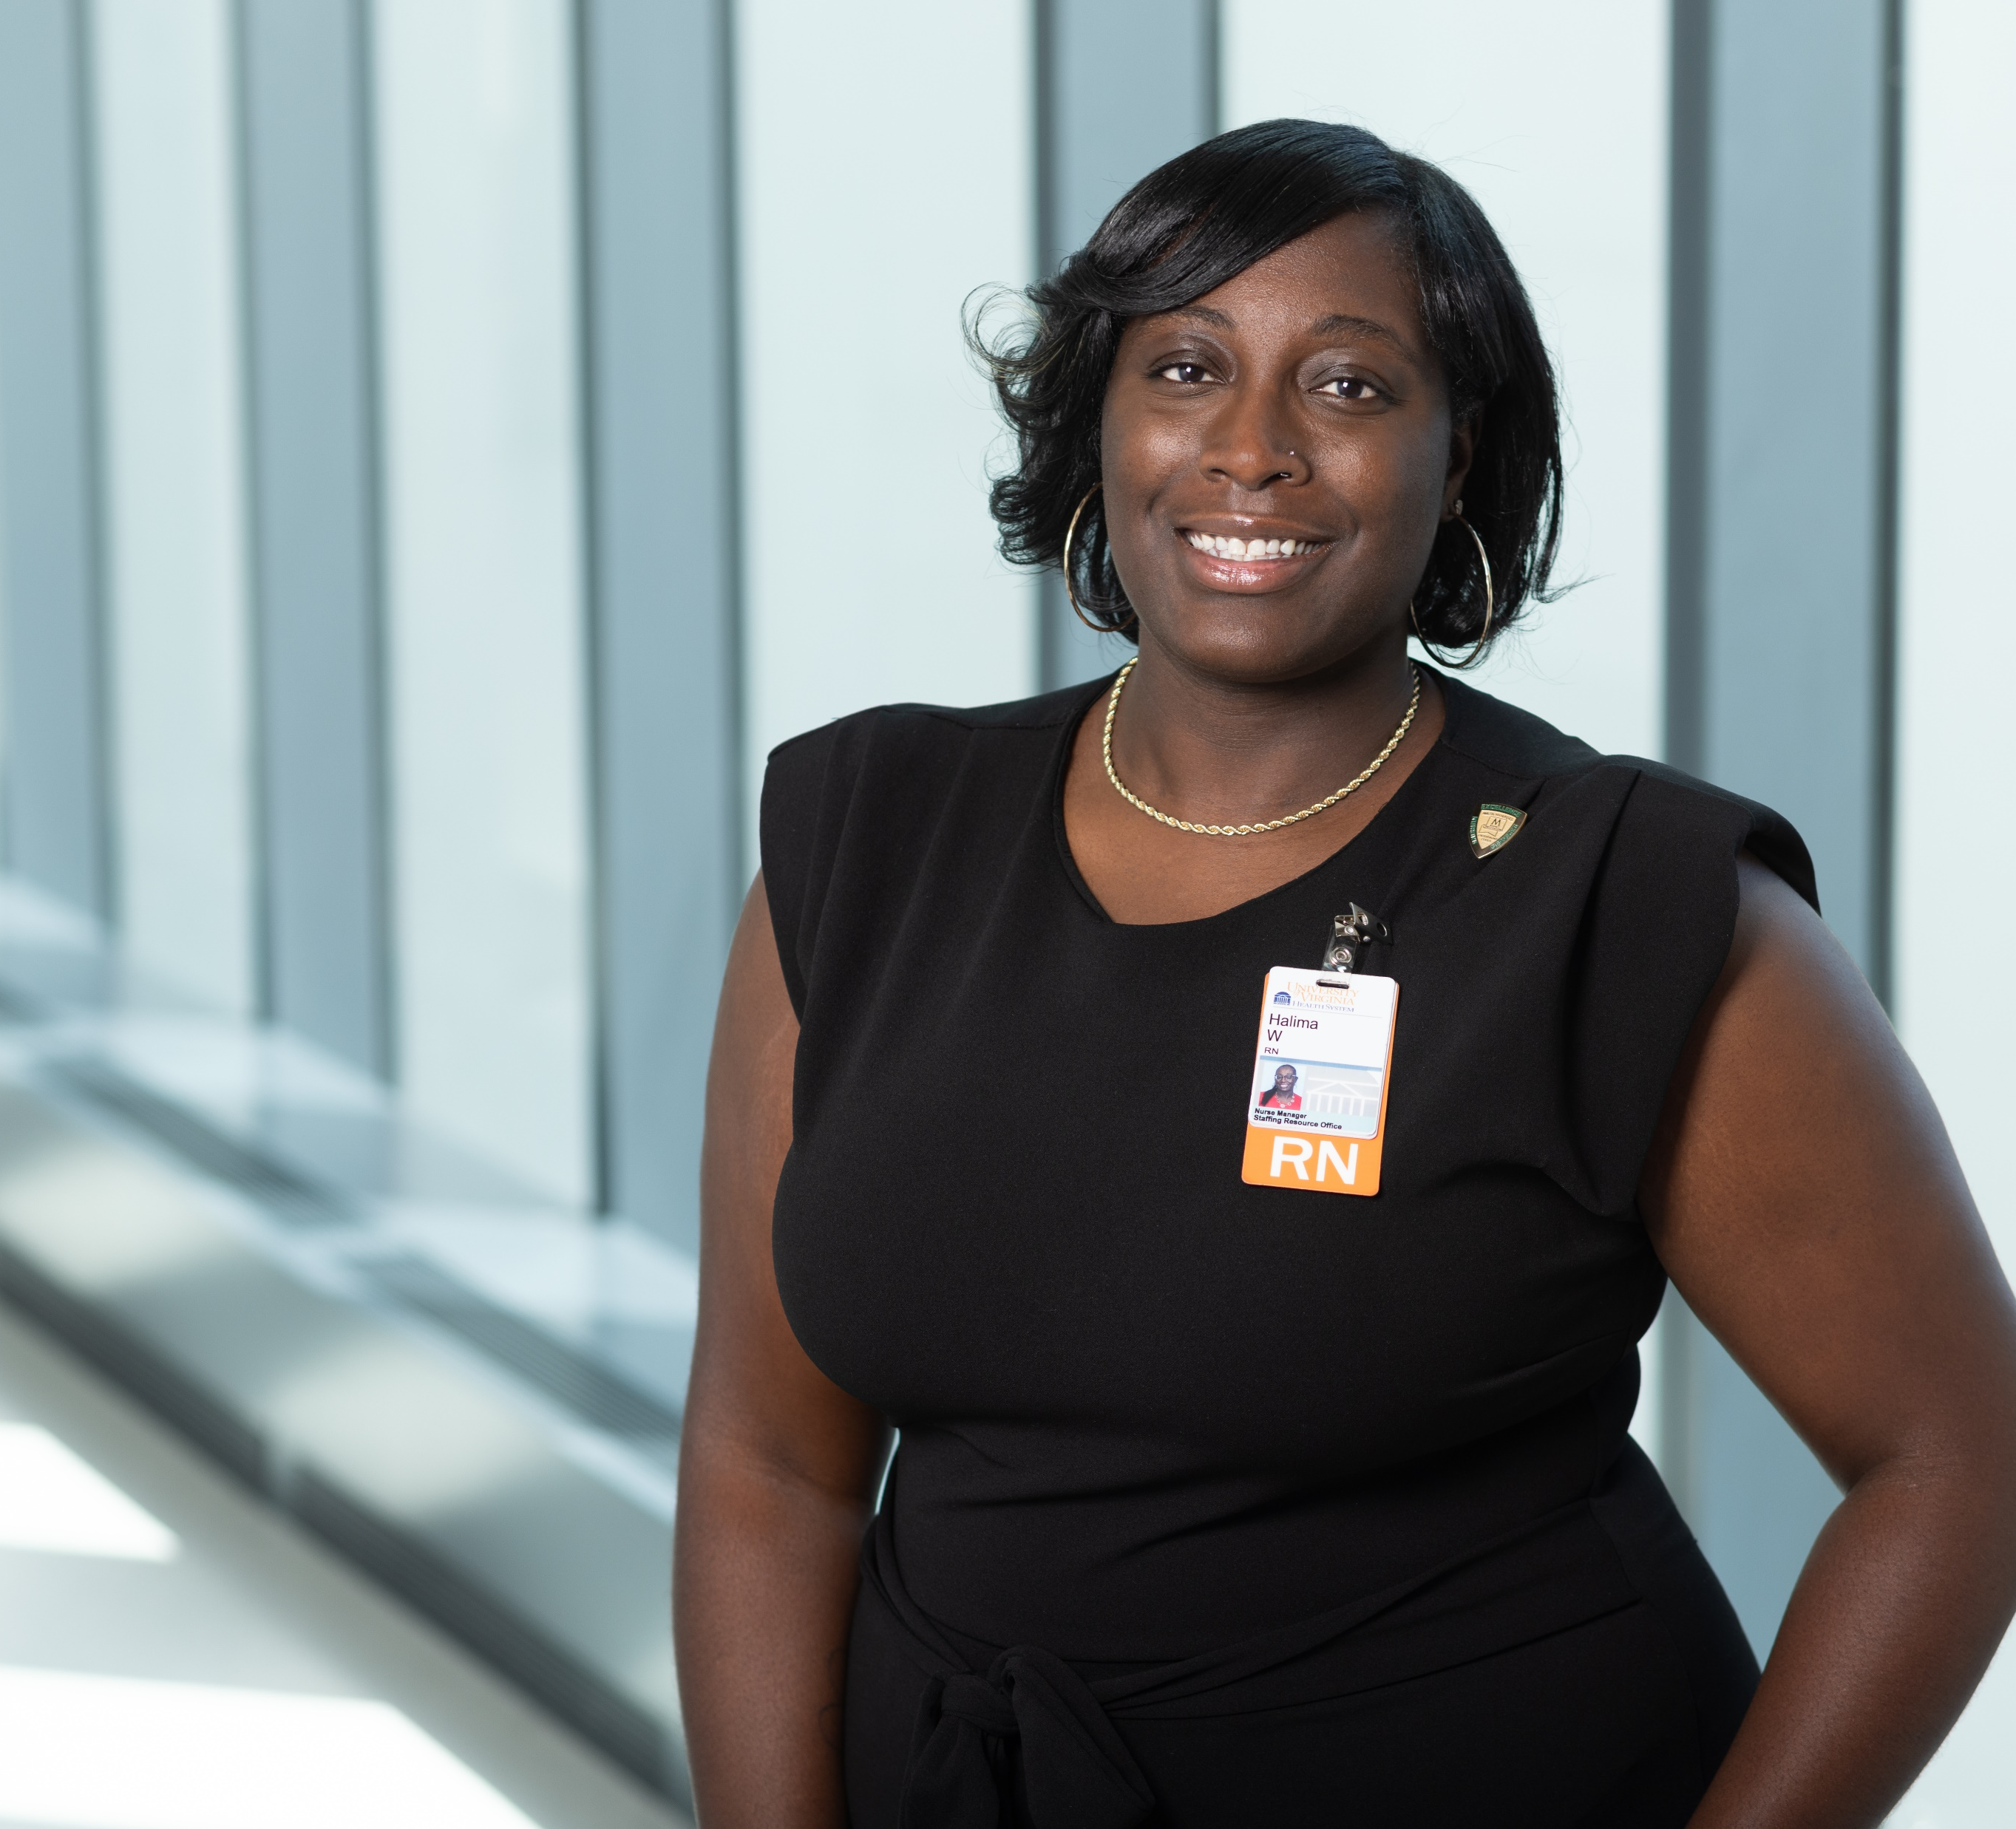
Magnet Minute
Halima Walker Promotes Health Equity
In September 2023, Nurse Manager Halima Walker proposed forming a team committed to improving health equity and the care of complex patients in the Heart & Vascular Service Line. Her proposal was accepted, and Halima was appointed as chair of the newly formed Heart & Vascular Center Health Equity and Complex Care Action Group.
Under Halima’s leadership, the team structured their work around UVA Health’s Strategic Plan, focusing on “cultivating healthy communities and belonging for all”.
Accomplishments included:
Procured data to guide health equity work
Connected with external DEI subject matter experts
Local promotion of health equity in the Fifeville community
Notes:
Nurse Manager Halima Walker is a leader in our Staffing Resource Office. Halima’s clinical background as a nurse has been in the Heart & Vascular Service Line, and through her clinical work experiences she observed opportunities to improve health equity in this patient population.
In September 2023, Halima proposed forming a team committed to improving health equity and the care of complex patients in the Heart & Vascular Service Line. Halima sought to have a psychologically safe space to talk about difficult issues related to health equity in Heart & Vascular through focused conversation and problem solving. Her proposal was accepted, and Halima was appointed as chair of the newly formed team, named the Heart & Vascular Center Health Equity and Complex Care Action Group.
As chair, Halima led the group to plan a mission for the committee’s work. The group sought to promote more positive health outcomes for cardiovascular patients by structuring their work around the “Cultivating healthy communities and belonging for all” section from UVA Health’s strategic plan as well as the Center for Disease Control’s Health Equity Indicator Conceptual Framework for Cardiovascular Disease.
Accomplishments by the group, under Halima’s leadership, include the following:
Obtained comprehensive data on heart failure and cardiac surgery patients, which showed disparities for Black patients in length of stay and 30-day readmission rates, when compared to other patients.
Connected with external DEI subject matter experts to educate committee members and inform their work.
Collaborated with other groups from UVA to screen community members in Fifeville for cardiovascular health, including gender-specific risk factor assessments, point of care testing for Hemoglobin A1C, lipid testing, and educational sessions.
Halima’s proposal to create a working team to address health equity for Heart & Vascular patients and team members demonstrates her commitment to contribute to an equitable health system and promotes health equity. Halima’s leadership and vision to advance the opportunity for all people to attain their highest level of health is contributing to efforts to promote health equity at UVA Health University Medical Center.

