Slide 1



Magnet Minute
ANCC Magnet Recognition® is an honor reserved for organizations that demonstrate commitment to transformational leadership, structural empowerment, exemplary professional practice, and new knowledge and innovation. As a Magnet-recognized organization, UVA Health University Medical Center nurses achieve excellence in these areas by leveraging our Nursing Care Delivery Model of Relationship-Based Care, shown at the center of our Professional Practice Model.
TL3EO
Provide one example of an improved patient outcome that aligns with a goal in the nursing strategic plan
Notes:
Magnet Recognition® is an honor reserved for organizations that demonstrate commitment to transformational leadership, structural empowerment, exemplary professional practice, and new knowledge and innovation. As a Magnet-recognized organization, UVA Health University Medical Center nurses achieve excellence in these areas by leveraging our Nursing Care Delivery Model of Relationship-Based Care, shown here at the center of our Professional Practice Model.
This Magnet Moment is for the TL3EO standard, which requires the following: Provide one example of an improved patient outcome that aligns with a goal in the nursing strategic plan.

Slide 2

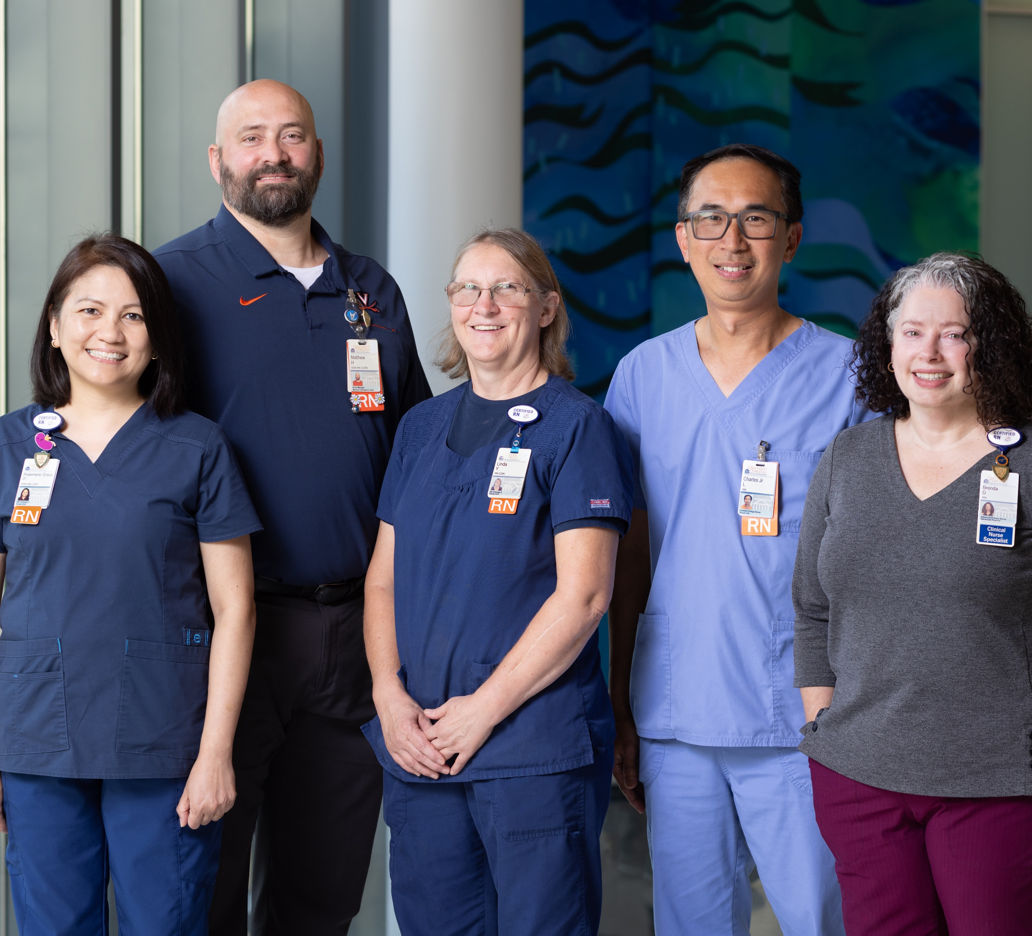
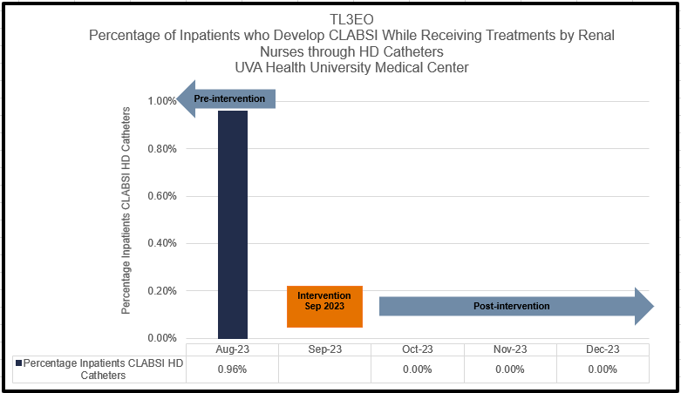
Magnet Minute
Renal Nurses Decrease CLABSI
Inpatient Renal Nurses sought to reduce CLABSI for admitted patients receiving treatments through HD catheters. The team identified opportunity to improve disinfection practices for HD catheter needleless connectors. They improved practice by counting out loud for 15 seconds while scrubbing needleless connectors.
As a result of their efforts, the percentage of admitted patients who developed CLABSI while receiving treatments by Renal Nurses through HD catheters was reduced from 0.96% to 0%. The team sustained zero CLABSI in this patient population for the remainder of calendar year 2023!
Notes:
An element of the UVA Health University Medical Center 2023 Nursing Strategic Plan is registered nurses contributing to superior patient outcomes. Key activities to achieve this include:
implementing additional clinical pathways to reduce unwarranted variation in care
Optimizing clinical care delivery through the enhancement of operational relationships
And Establishing new or leveraging existing forums to promote inter-professional and inter-department collaboration to address care delivery barriers.
The inpatient Renal Team demonstrated excellence in this standard through their work in CLABSI reduction. The team cares for adult and pediatric inpatients receiving hemodialysis, ultrafiltration and apheresis treatments. Renal nurses perform these treatments in either the Renal Unit or portably, by going to the patient’s home unit. In August 2023, the team completed 311 treatments utilizing an HD catheter. During this same month, three of those patients developed a CLABSI. This meant 0.96% of patients in whom a HD catheter was in place and being utilized during admission to the hospital developed a CLABSI. One element where the team saw opportunity for improvement was in the practice of disinfection for HD catheter needleless connectors.
In September 2023, the renal team evaluated their own practice in adhering to the University Medical Center’s evidence-based Central Line Maintenance Bundle. The Bundle instructs nurses to scrub needleless connectors for at least 15 seconds. The renal team identified opportunity to improve their compliance with disinfection for high-risk lines, and decided to measure their own compliance with 15 seconds of disinfection through observations. Brenda Deller, Clinical Nurse Specialist, and Matt Henrich, Nurse Manager, led the team in counting out loud while scrubbing the HD catheter needleless connector for the required institutional standard of 15 seconds of disinfection. The practice of counting out loud helped ensure that disinfection took place for the entire 15 seconds and gave increased accountability to this practice. To verify compliance with 15 seconds of scrubbing, seven team members served as observers and validators, including clinical nurses and the Nurse Manager. After informing the nurses on the Renal Unit of the change, the validator team conducted observations of peers scrubbing HD catheter needleless connectors prior to access and verified if the team member counted out loud during the 15 seconds of scrubbing. In an effort to capture accurate results, the validators sought to complete observations when their peers were not aware they were being observed. The renal team also included patients in this new initiative. In addition to verbally explaining the change, renal nurses hung posters in the rooms of patients receiving treatments on the Renal Unit that explained why nurses were counting out loud for 15 seconds and how the practice helped to prevent infection. The renal team’s efforts proved to be successful. Patients who received treatments from the renal team via a HD catheter experienced zero CLABSI from October through December 2023, following the implementation of counting out loud for 15 seconds with a focus on disinfection of needleless connectors. Ensuring thorough disinfection of the needleless connectors contributed to decreasing the introduction of harmful organisms into the patient’s bloodstream. The education provided to patients on this practice and the display of posters in patient rooms supported increased awareness among team members and patients on CLABSI prevention efforts, further fostering a culture of safety.

