Slide 1



Magnet Minute
ANCC Magnet Recognition® is an honor reserved for organizations that demonstrate commitment to transformational leadership, structural empowerment, exemplary professional practice, and new knowledge and innovation. As a Magnet-recognized organization, UVA Health University Medical Center nurses achieve excellence in these areas by leveraging our Nursing Care Delivery Model of Relationship-Based Care, shown at the center of our Professional Practice Model.
TL4a
Provide one example, with supporting evidence, of a Nurse AVP's/Nurse Director's advocacy for resources to support an organizational goal.
Notes:
Magnet Recognition® is an honor reserved for organizations that demonstrate commitment to transformational leadership, structural empowerment, exemplary professional practice, and new knowledge and innovation. As a Magnet-recognized organization, UVA Health University Medical Center nurses achieve excellence in these areas by leveraging our Nursing Care Delivery Model of Relationship-Based Care, shown here at the center of our Professional Practice Model.
This Magnet Moment is for the TL4a standard, which requires the following: Provide one example, with supporting evidence, of a Nurse AVP’s/Nurse Director’s advocacy for resources to support an organizational goal.

Slide 2

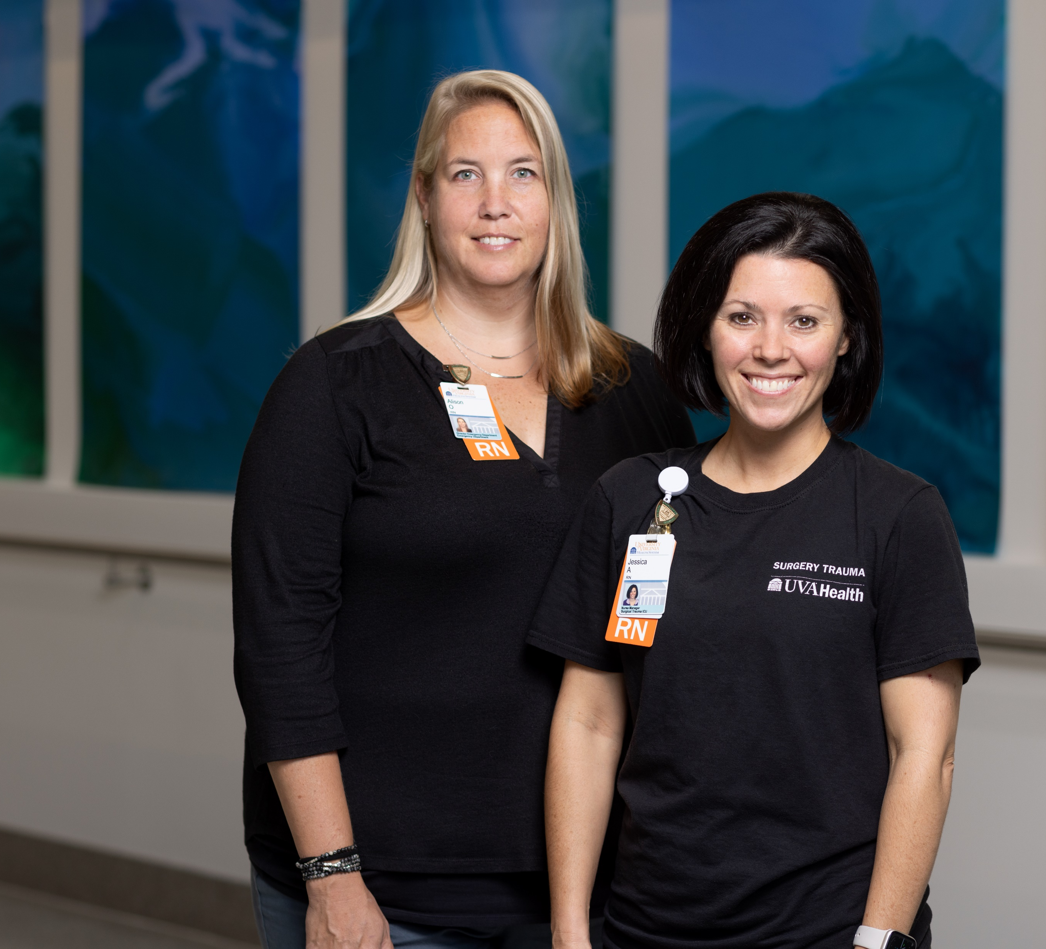
Magnet Minute
Implementation of the Trauma Response Nurse Role
Inpatient Nurse Director Alison Okerlund sought to improve the care of the critically ill Alpha Trauma patient, who often requires intensive stabilization care and diagnostics during the Emergency Dept (ED) phase of care. In May 2022, Alison led an interdisciplinary team to create the TRN role, comprised of a STICU RN who responds to Alpha Trauma alerts.
Alison collaborated with Jess Alford, STICU Nurse Manager, and many other clinical nurses and interdisciplinary team members. They were successful in adding 0.06 FTE to the STICU staffing grid to support the new role. After a pilot phase, the team covered >70% of Alpha Trauma alerts with a TRN, and measured a 19 minute total decrease in ED Dwell Time for Alpha Trauma patients. This improvement was sustained, and the team saw a 35.5 minute reduction in 2023 average ED Dwell Times.
Notes:
Alison Okerlund, inpatient nurse director, sought to improve the care of the critically ill Alpha Trauma patient. High acuity trauma patients require intensive stabilization care and diagnostics during the Emergency Department phase of care. ED nurses have historically supported the trauma team at the time of patient admission in the trauma bay, however, the intensity of complex trauma care required a 1:1 patient assignment to fully support all the patient’s needs throughout the ED continuum to ICU disposition, creating additional assignment compression for the rest of the ED staff. This led to longer ED Dwell Times for complex trauma patients. The Trauma Program aimed to decrease ED Dwell Times for trauma patients needing admission to the ICU.
Beginning in May 2022, Alison collaborated with Jess Alford, STICU Nurse Manager, many clinical nurses from the ED and STICU, in addition to an interdisciplinary team to create the Trauma Response Nurse (TRN) Role. They successfully advocated to add 0.06 FTE to the STICU staffing grid to support the TRN role, which allowed an experienced STICU RN, cross-trained to the ED environment, to respond to Alpha Trauma alerts.
The team set a goal to maintain total ED Dwell Time, the time the Alpha Trauma patient spends in the ED, to less than 2 hours. This goal was in alignment with the organizational goal “Strengthening our Foundation: Easy Access and Superior Patient Outcomes” as outlined in the UVA Health Strategic Plan.
Under Alison’s leadership, clinical nurses from the STICU delivered education and training for nurses about the TRN role. After a pilot phase, the team covered greater than 70% of Alpha Trauma alerts with a TRN. They met the goal set to maintain ED Dwell Time less than 2 hours and measured a 19 minute total decrease in ED Dwell Time for Alpha Trauma patients during the pilot. Improvements were also observed in compliance with trauma admission ED temperature measurements and in team member satisfaction. Qualitative feedback from team members included comments such as “this is making me enjoy work more”. The successful reduction in ED Dwell Times was sustained beyond the pilot period, and the ED Dwell time for 2023 averaged 98.5 minutes, improved from the 2022 time of 134 minutes. Alison’s advocacy for the TRN role and leadership of the team led to the addition of the new position and positively impacted the organizational goals of enhanced patient progression and superior patient outcomes.

