Slide 1
Magnet®
Recognition
Published: September 2025
Questions? Email NPGO@uvahealth.org

Slide 2
Magnet® | What is it?
The Magnet Recognition Program® recognizes health care organizations for quality patient care, interdisciplinary collaboration, nursing excellence and innovations in professional nursing practice. Developed by the American Nurses Credentialing Center (ANCC), Magnet® is the leading source of successful nursing practices and strategies worldwide.
Notes:
What is Magnet?
This is the definition from the ANCC which is the credentialing body for Magnet, but the words that really tell you what Magnet is are bolded. Magnet designation is a voluntary process in which organizations hold themselves to a set of evidence based standards to demonstrate:
Overall quality
Interdisciplinary Collaboration
High standards for nursing practice
Innovations through quality improvement and Nursing Research
Magnet is nursing centric, but cannot be achieved or maintained without the support and collaboration of executive leadership and many disciplines.

Slide 3
Magnet® | How did it start?
1980s nursing “shortage”
Task Force created to study the hospitals that were recruiting and retaining like “magnets”
41 hospitals included
14 common themes that became the “14 Forces of Magnetism® Model”
  2006 UVA Designation Model
Notes:
In the 1980s, while there were more nurses than ever, but 80% of hospitals had inadequate staffing levels
The leaders of the American Academy of Nurses organized a task force to address the nursing shortage. The task force then decided to study various hospitals that were NOT having a problem recruiting and retaining staff.
165 hospitals were nominated, 155 consented to be studied, after review of their data 46 qualified for inclusion, and 41 participated in the study.
After studying the 41 hospitals, the researchers found that they shared 14 themes that attracted nurses to the hospitals. LIKE MAGNETS!
These 14 themes became the 14 forces of Magnetism- First Magnet Model and the one that we designated under the first time in 2006.
Since the first Magnet hospital was designated in 1994 (Washington Medical Center, Seattle, WA) the program has grown, become more structured and has become an international honor. The ANCC is committed to a scientific approach to evaluating the process and outcomes of becoming a magnet hospital- this evidence based approach has made this one of the most stringent and respected models representing quality care.

Slide 4
Evolution of Magnet®
2008 Magnet® Manual was simplified to 5 components
Revised to include quality data
  Nurse Sensitive Clinical Indicators
  Patient Satisfaction
  RN Engagement/Satisfaction
Revised every 4 years based on analysis and evidence
UVA Health University Medical Center designations:
  2006
  2015
  2020
  2025
Notes:
Natural evolution of the Magnet model is reflected in the changes to the magnet requirements over time. 14 forces model required that we tell stories about how we demonstrated the 14 forces.
However, If you can attract and retain nursing talent, then you should have great outcomes.
In the 2008 revision- model streamlined to 5 components and there was a shift to include outcomes and was very “data heavy” compared to the 14 Forces version. Increased emphasis on inter-disciplinary collaboration. This shift from a heavy story telling model to a combined story telling and data model led to a hard moment of truth for us here at UVA. We were due to re-designate in 2010 and when we evaluated our situation in the context of this data heavy model, we found that we were not meeting the outcomes expectations of a Magnet hospital. We voluntarily withdrew from our re-designation and set about improving our structures and processes so that we could achieve those outcomes.
The next revision occurred in 2014, (Model remained the same) and the standards were revised creating even more emphasis on outcomes and revised again for the 2019 Manual- our most recent document was written to these standards. Revised again for organizations submitting 2023 and later.
This approach to revising standards is a demonstration of how the ANCC is committed to it’s own version of continuous improvement and commitment to integrating new evidence into the Magnet standards.

Slide 5
Why bother?
Best evidence based model for highly professional nursing practice environment
  Clinical Excellence/Innovations
  Collaboration
  Professional Development
Attract and retain!
Commitment to Magnet® principles leads to excellent outcomes
Makes good business sense!
Notes:
A lot of time, money and energy are invested in achieving and maintaining a magnet designation. So why bother?
Magnet is the best evidence based model for a highly professional nursing practice environment. It is a great structure and process road map that leads to outcomes. You cannot have a great hospital without great nursing.
When you have a highly professional practice environment, you are more likely to be able to attract and retain your nursing talent which also supports better outcomes.
From a business perspective, all of these things make good business sense. In an environment where consumers are increasingly seeking quality, and when we are facing the kinds of pressures we are facing in this industry, we have to have a framework of standards for the nursing practice environment. Nurses make of one-third of the workforce in our organization.
Impact of Magnet Designation on rankings:
US News & World Report U.S. News 2023-2024 Best Hospitals Honor Roll- all of the hospitals are Magnet designated
In the Leapfrog Hospital Survey , Magnet designation automatically earns full credit for Safe Practice #9 Nursing Workforce, which scores hospitals on commitment to staffing with highly trained nurses and putting nurses in leadership positions that allow them substantial input on patient safety issues.
Magnet requires organizations to develop, disseminate and enculturate evidence-based criteria that result in a positive work environment for nurses and, by extension, all employees. In the 2019 Fortune 100 Best Companies to Work For®, 3 of the 4 hospitals/systems organizations are Magnet-recognized facilities or have Magnet facilities in their system.
As of September 2025, there are only 642 Magnet designated hospitals worldwide. In the US, approx. 10% of hospitals have Magnet status. Now approximately 30 in Virginia- very dense Magnet market.

Slide 6

Process
Gap analysis- are we ready?
Compile the evidence
Write the document
Document review (avg. 4 months)
Site visit
Magnet® Commission reviews findings
Designation!
Four year cycle
Notes:
Where do you begin?
First you start with a gap analysis to know where your Magnet strengths and vulnerabilities may be. Sometimes you realize you are meeting the standards and sometimes you may find that you need additional structures or processes in order to meet a Magnet expectation. Sometimes you have to “Step up to” a Magnet standard.
Then you start compiling evidence and write the document and submit it to ANCC for review by the Magnet program office and a team of trained Magnet appraisers.
Typical document review takes about 4 months and if your document scores well enough you get a site visit and the compiled document/site visit findings are reviewed by the Commission on Magnet. The appraiser team doesn’t make the designation decision, they provide a report to the Commission who makes the decision.
Once you earn a Magnet designation…
In four years you get to do it all again! The process for re-designation is not easier- and it’s not abbreviated. It’s a complete do-over of the whole process.

Slide 7
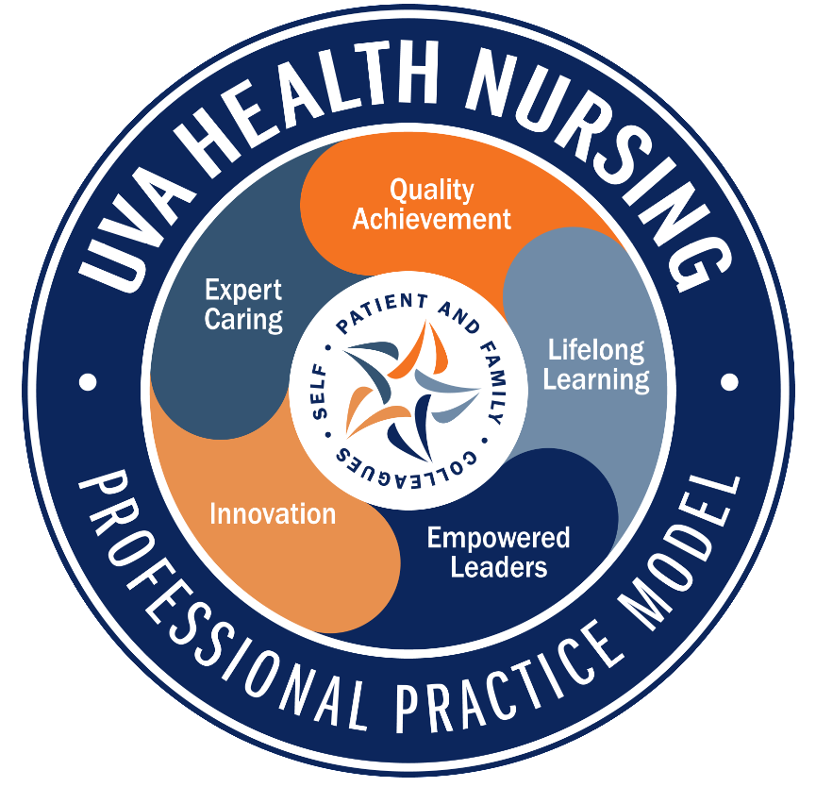
Site Visit | Verify, Clarify & Amplify
4 Magnet® Appraisers, 4 days
Negotiate agenda to optimize time with nurses
Random selection from scheduled nurses
Selected groups/ committees
Practice area visits
Nurses must be able to speak to their practice
  Nursing Professional Practice Model as framework for HOW to articulate practice
  Nursing quality data
Notes:
Let’s spend a few minutes on site visit.
Earning a site visit doesn’t guarantee that you will re-designate.
The purpose is to verify that what we wrote was true, and clarify anything that they feel they need to further explore, and to amplify- this is there chance to experience our Magnet culture.
For a hospital our size, we will have 4 appraisers for 3-4 days. It will occur about 6 weeks after you are notified that you are going to site visit.
We work with the lead appraiser to negotiate for an agenda that will provide them with the most opportunities to interact with clinical nurses.
They will request the schedules for nurses on the site visit days and from those lists, they will give me a list of random names of nurses they will want to meet with.
They will ask to meet with some specific groups and committees, but mostly they want to spend time in the care environment with direct care nurses.
Nurses don’t need to know the Magnet model- they need to be able to speak about their practice. Last time we very successfully used our PPM to help nurses do that- and I expect we will do that again.
All nurses need to be familiar with their area quality data and be able to speak to how they compare and what they are doing to improve.
Will touch on our likely timeline in a bit and more about preparations… but…
We may do another mock site visit to help prepare the organization and we will definitely invest time in individual group prep sessions.

Slide 8

Who does the work?
Magnet Core Team
Magnet Steering Committee (convenes ~18months prior to document submission)
Magnet Contributors- Clinical nurses throughout the organization
  Communicators
  Information gatherers
  Support events/site visit
Notes:
Magnet Core team- this is the group that will spend the most hands on time writing and formatting the document, inserting and staging the supporting evidence and planning events.
Magnet Steering committee composed of NPGO leaders and is an oversight group that keeps tabs on the process and progress of the re-designation work and serves as our Magnet help chain.
We also have a small army of Magnet contributors. These are nurses and leaders that serve as communicators about the process, can help find evidence and stories, that help give feedback on our events and help with site visit.

Slide 9
“Provide an example, with supporting evidence…”
Notes:
Every single standard begins with this phrase.

Slide 10
Empirical Outcomes “EO” Standards | Non “EO” Standards (Non- EO)
Narrative- tell the story (specific headers) Supporting evidence: Graphed Outcome Must include: Pre-intervention data point Clear intervention point At least 3 post-intervention data points better than the pre-data Must match the goal statement Rates, rather than raw numbers Timelines must match up | Narrative- tell the story Supporting evidence: Attachments that support/prove the story Up to 5 pieces per example Minutes Emails Policy/Procedures Internal publications Purchase orders Presentations
Notes:
There are about 104 examples that we need to provide to demonstrate how we meet the Magnet standards, they fall into 2 types:
The Empirical Outcomes or “EO’s” and the NON- EO’s
For the EOs we have to tell the story- and there is a specific format required- The supporting evidence provided with the EO’s is a graphed outcome. The graph must include pre-intervention data, a clear intervention point, and then at least 3 post intervention data points. They do not want process measures, and they want them to all be represented as a rate.
The NON-EO’s- we still have to tell the story, but the supporting evidence for these standards are attachments that support the story and prove that it is true. We can have up to 5 pieces of supporting evidence for each example. These are things like minutes, emails, calendar planners, etc.
You are allowed to include any data/work between designations. Our window from which we can pull stories and data from for this document, is May 2025 – January 1, 2029.

Slide 11
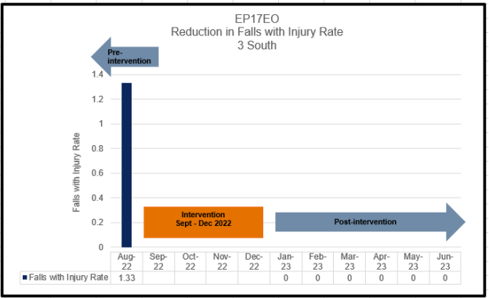
…an improved patient safety outcome associated with clinical nurse involvement in the evaluation of patient safety data at the unit level.
Notes:
This is an example of the required graph formatting. This is from one of our stories about how nurses on 3 South worked to improve patient falls with injury.

Slide 12
The Big “Data Buckets”
Nurse Sensitive Clinical Indicators (2 years/8 quarters of data)
  Inpatient: 4 nationally benchmarked
    Falls w/ Injury (required)
    HAPI Stage 2 and Above (required)
    CAUTI
    CLABSI
  Ambulatory: 3 required, 2 must be nationally benchmarked
    Falls w/ injury
    Patient burns
    Surgical Errors
Nurse Sensitive Patient Satisfaction (2 years/8 quarters of data)
  Inpatient
  Ambulatory
RN Engagement Survey* - the most recent survey within 30 months of document due date
Notes:
In addition to the written stories, there are 3 big data Standards.
For each of these, we are required to report these data elements in all areas where these outcomes are measured.
The first is nurse sensitive clinical indicators. For this one, we have to provide 8 quarters or 2 years of data. And here is what we are reporting….. For this most recent designation, that is some of calendar year 2022 and 2023, and the first quarter of 2024.
The second big data standard is Nurse Sensitive Pt. Satisfaction. We have 9 categories and the eligible questions are pre-negotiated between Press Ganey and the ANCC.
The most recent RN Engagement Survey data.

Slide 13
Meeting the Magnet® Standard
51% of the areas (units/clinics/departments) outperform the national mean,
51% of the time
(5 out of 8 quarters).
Notes:
I want to explain what it means to meet the magnet standard. For these big data standards, to meet the magnet standards, 51% of the areas must outperform a national benchmark (mean or median) 51% of the time.
COMPARE GROUP- large Academic Medical Centers

Slide 14
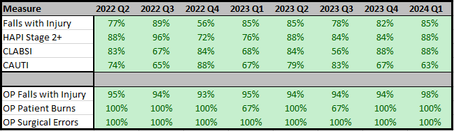
Nurse Sensitive Clinical Indicators
Outperformed on all NSIs for all quarters presented!

Slide 15
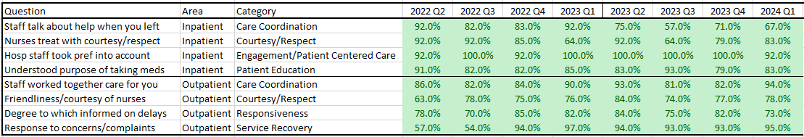
Patient Experience
Outperformed on all PEX for all quarters presented!

Slide 16
RN Engagement (Oct. 2022 Survey)
ANCC Category* | Number of Units that outperform Jan 2023 Natl Avg | Percent of Units above the Jan 2023 Natl Avg
Fundamentals of Quality Nursing Care | 59 out of 100 | 59.00%
Autonomy | 63 out of 100 | 63.00%
Professional Development | 63 out of 100 | 63.00%
Interprofessional Relationships | 57 out of 100 | 57.00%
Leadership Access and Responsiveness | 51 out of 100 | 51.00%
Adequacy of Resources & Staffing | 48 out of 100 | 48.00%
RN to RN Teamwork and Collaboration | 61 out of 100 | 61.00%
To meet the standard: Outperform on 4 categories
Site Visit Eligibility: Must outperform on 3 to be granted a site visit
Notes:
For this standard, we are required to report on 4 categories,
What is special about the engagement standard is that it is an ELIGIBILITY standard. This means that it can be a deal breaker for your designation. To meet the Magnet standard, you must outperform on 4 of these categories.
If you are only outperforming on 3 of 7, you can still get to site visit, but the appraisers will surely be digging into those deficiencies during your site visit.
If you don’t have at least 3, then that is the end of the road. You will not get to site visit.
Nationally engagement is a challenge. If we don’t meet the expectations, we have the opportunity to do focused pulse surveying to demonstrate improvement.

Slide 17
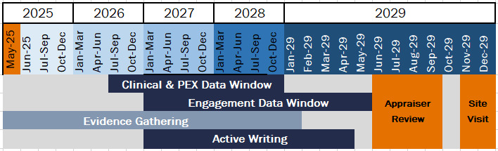
Document due June 1, 2029!
Notes:
We received designation in May 2025.
We are now in the evidence gathering phase and looking for stories for our next document, which will be due to submit on June 1, 2029.

Slide 18
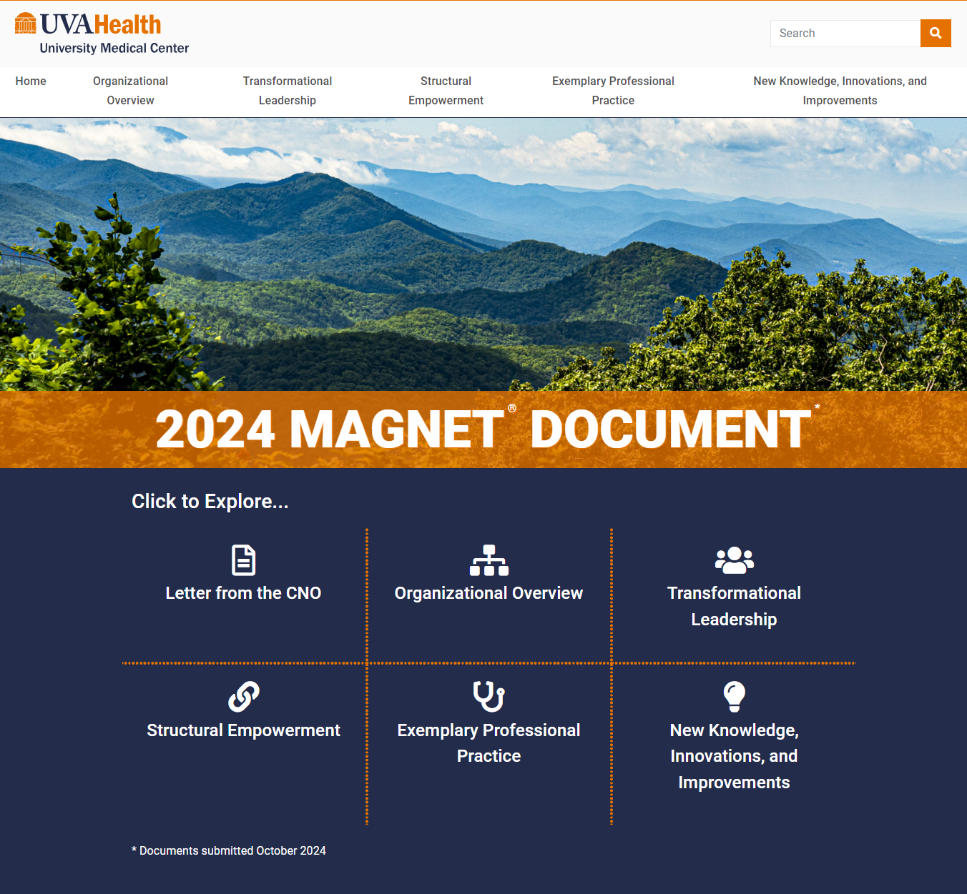
By the numbers:
91 required standards
735 pages of written narrative
436 team members featured in the narratives
2704 pages of supporting evidence
418 graphs
www.UVAHealthUMCmagnet.com
Notes:
Our full 2024 document is available on our website, which is available externally.
I invite you to peruse through the stories and examples we submitted in the 2024 Magnet document. You may use the search bar in the top right to find departments, team members and topics.
And take a moment to reflect on and celebrate the work that’s been done in the past four years!

