Slide 1
FY25 RN Peer Review
NPGO Professional Development Committee

Slide 2
Peer Review…
is a best practice as written into both the ANA Code of Ethics and Scopes & Standards. The categories are based on our Professional Practice Model.

Slide 3

Code of Ethics for Nurses
5.2 Professional growth and maintenance of competence
Though it has consequences for others, maintenance of competence and ongoing professional growth involves the control of one’s own conduct in a way that is primarily self-regarding.
Competence affects one’s self-respect, self-esteem, professional status, and the meaningfulness of work. In all nursing roles, evaluation of one’s own performance, coupled with peer review, is a means by which nursing practice can be held to the highest standards.
Each nurse is responsible for participating in the development of criteria for evaluation of practice and for using those criteria in peer and self-assessment.

Slide 4
ANA Scope and Standards of Practice, 4th Edition, Standard 16
“Registered Nurses shall engage in self-reflection and self-evaluation of nursing practice on a regular basis, identifying areas of strength as well as areas in which professional growth would be beneficial.”
Registered Nurses “seek feedback regarding one’s own practice from healthcare consumers, peers, colleagues, supervisors, and others” and “provide peers and others with constructive feedback regarding their practice or role performance.”

Slide 5
Purpose: Stimulate professionalism through increased accountability and promote self regulation of practice.
A peer is someone of the same rank *
Peer review is practice-focused
Feedback is timely, routine, and a continuous expectation
Peer review fosters a continuous learning culture of patient safety and best practice
Feedback is not anonymous
Feedback incorporates the nurse’s developmental stage
*Rank- level, position

Slide 6

Nursing Professional Practice Model
The Nursing Professional Governance Organization (NPGO) is the professional governance structure for UVA Health University Medical Center nurses.
Our Nursing Professional Practice Model (PPM) integrates all of the NPGO's core principle and depicts the work of all UVA Registered Nurses.
Our Nursing Care Delivery Model is Relationship-Based Care, and University Medical Center nurses adopt an evidence-based approach to nursing practice.
Notes:
Professional Practice Models provide a visual representation of nursing’s contribution in an organization. The model
includes values and goals that define the professional nursing identity.
The model captures
the professional elements and relationships that define the complex role of the nurse.
It highlights the work of UVA Nurses in all our unique practice settings.

Slide 7
Flipping the Script in FY25
Come to Peer Review prepared to talk about yourself - what is working and what can be improved upon as an area for professional growth for yourself.
Invite reflections and input from your peer.
Then, listen to your peer’s reflections and share your insight and input regarding their strengths and areas of growth for them.
Note: Peer reviews are not crucial conversations – those should be held separately.

Slide 8


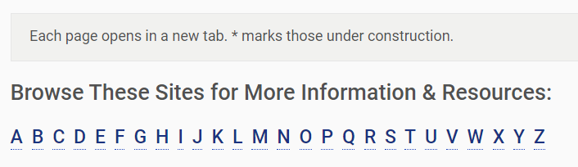
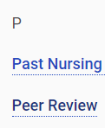
Resources for Peer Review: NPGO Website
OR

Slide 9
Resources for Peer Review:
Timeline and Process Steps – includes guidance for making pairs
Peer Review Prep Tool
Examples (written and video) – including new Designated Charge Nurse example
Job Aid for how to request Peer Reviews in Workday
STICU’s example for using Local Governance Committee to select non-self-selected pairs
Peer Review Tracking Grid for leaders
Operational Guideline - additional details for peer review process and including contracted team members
Peer Review Process Steps for Nurse Leaders
Nurse Leader Peer Review Prep Tool
Flyer with FY25 details

Slide 10
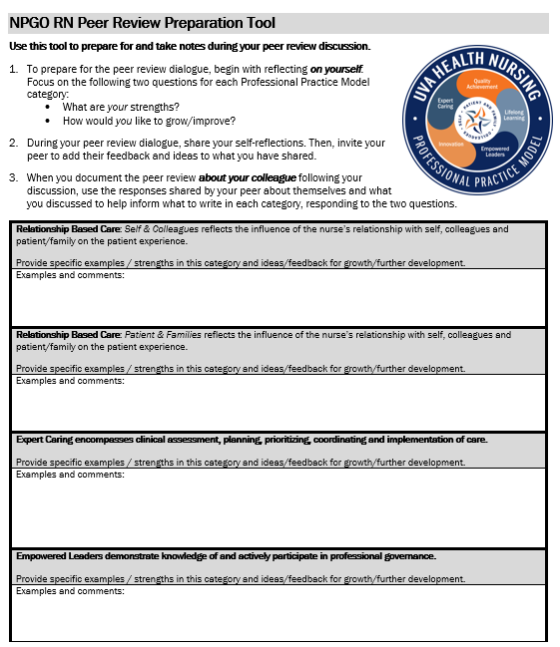
Peer Review Prep Tool
Notes:
Additional instructions provided

Slide 11
Recommended Timeline
November - December 2024 |  | February - March 2025 |  | Spring 2025
Complete 1st Peer Review Non-Self- Selected Paired by*: Local Professional Governance Committee Or Manager |  | Complete 2nd Peer Review Self-Selected |  | Ready for Annual Performance Appraisal *Specific due dates shared each year by leadership and HR
For specifics about the Annual Performance Appraisal timeline, tools and more, please access the HR Performance Management website.
*Recommend create/communicate pairs in advance as part of the preparation process.

Slide 12
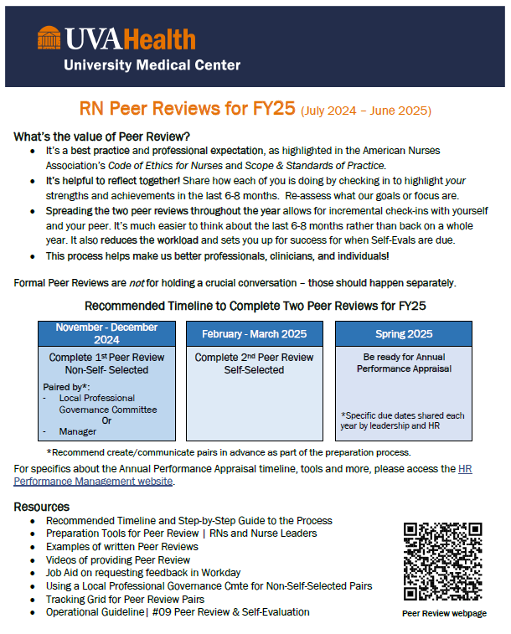
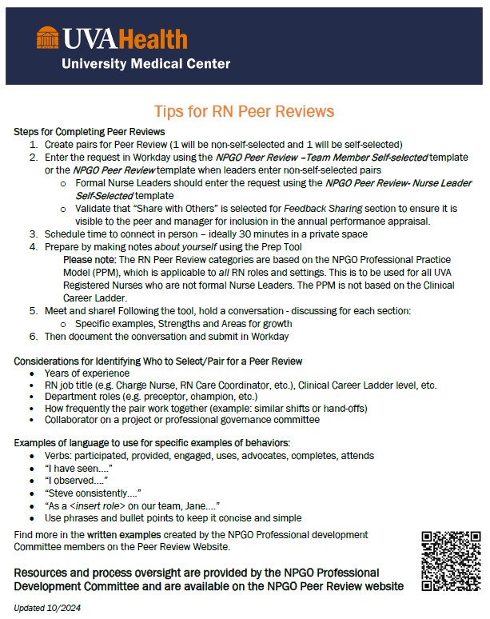
Notes:
Website: https://uvanpgo.org/intranet/professional-development-continuing-education/peer-review-resources1/peer-review-resources/
Flyer: https://uvanpgo.org/intranet/professional-development-continuing-education/peer-review-resources1/peer-review-resources/peer-review-timeline-and-steps/rn-peer-review-flier-fy24/

Slide 13

RN Peer Review Website

