Slide 1
Evaluating Nursing Professional Governance
May 2025
Notes:
As a Magnet organization, we demonstrate a strong commitment to evaluating our structures, processes and outcomes. Our NPG committee structure has been evaluated using own evaluation surveys and our RN Engagement survey. Previously, validated tools have been considered, but were very lengthy with 100+ questions. Recently, the Verran Professional Governance Scale (VPGS) was revised and is now only 22 questions. This provides us with an opportunity to evaluate our structures using a standardized instrument.

Slide 2
All RNs, ANMs/Nurse Managers:
Verran Professional Governance (VPGS) Scale©
Core Survey- 22 questions (1 disagree – 7agree scale)
Measures 3 subscales
  Professional Obligation- “a nurse's commitment to uphold the principles and practices of the nursing profession, demonstrating ownership and responsibility for their actions and decisions, and contributing to the advancement of nursing and patient outcomes”
  Collateral Relationships- “peer-based relationships and interactions that support an empowered workforce and professional decision-making.”
  Decision-making- “nurses' perceptions of their ability to participate in and influence decisions that impact their practice, professional growth, and patient care, as part of the broader concept of professional governance.”
Results
  Composite: average score across all items
  Subscale scoring
  Individual item scoring
Notes:
The VPGS measures nursing professional governance behaviors, including the attributes of professional obligation, collateral relationships, and decision-making, that contribute to the creation of nursing professional governance evidenced by an empowering work environment and the delivery of exemplary clinical care.
The VPGS can also assist nurses and other stakeholders to better understand the relationship between the structures, processes, and behaviors of nursing professional governance and their impact upon nursing, clinical, and organizational outcomes.

Slide 3
Director → CNO Level Leaders:
The Structural Professional Governance Self-Assessment Survey (SPGS-A)
The information gathered through SPGS-A provides context for the nurse leader to address nursing behaviors associated with implementing professional governance and helps assess both the processes and impact of ongoing professional governance practices.
Part A- Structures for Nursing Professional Governance- 11 items
Part B- Purposes of Nursing Professional Governance- 9 items
Part C: Professional Governance Bylaws for the Professional Nurse Organization- 7 items
Notes:
Leaders at or above the Director level will also receive an additional 27 questions in the Structural Professional Governance Self-Assessment Survey. When used in conjunction with the VPGS, the nurse leader can develop deeper insights into the relationship between professional structures and the behaviors they facilitate or support in a professional practice environment.
This set of questions will only go to:
Directors
Administrators/ACNOs
CNO

Slide 4
Survey Questions: Demographics
  Role
  Region
  Local practice setting (drop down list based on Region selection)
  Number of years licensed as a nurse
  Number of years as a nurse at UVA Health University Medical Center
  Nursing Degree
  Primary Shift
  OPTIONAL- name/contact info to be entered for a prize drawing

Slide 5
Results Analysis/Groupings
  Local practice setting with 5 or more responses
    Settings with less than 5 responses will be rolled up to the next level
  Region
  Organization
  Director Groupings
Notes:
Results analysis levels/groupings:
Practice setting (as defined by cost center) with 5 or more responses
Regional
Organization level
Director level

Slide 6
Timeline
Survey window: June 9th – June 29th Extended!
  Monday/Thursday response updates to Managers
Results August 14th – September 12th
Notes:
Survey will be open on June 9th with an email from the Office of the CNO and will remain open until 2359 on June 29th.
Results will be shared at all NPGO meetings from July 10th to August 8th and the Org-wide Nursing Leaders meeting on July 15th.

Slide 7
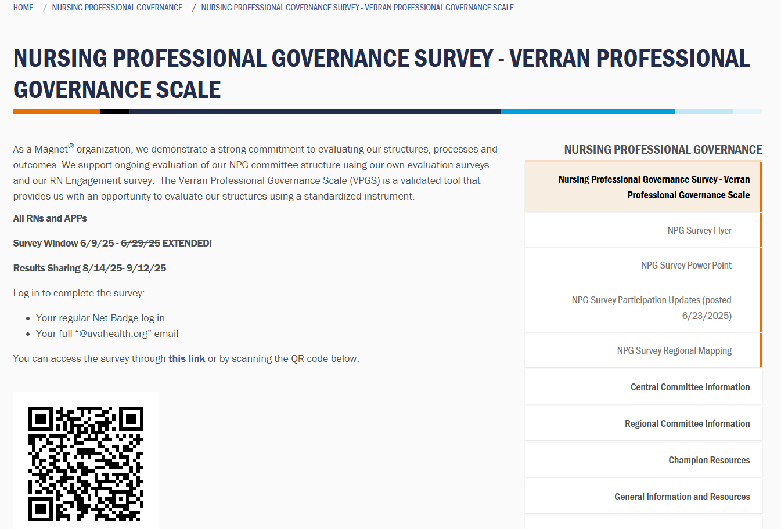
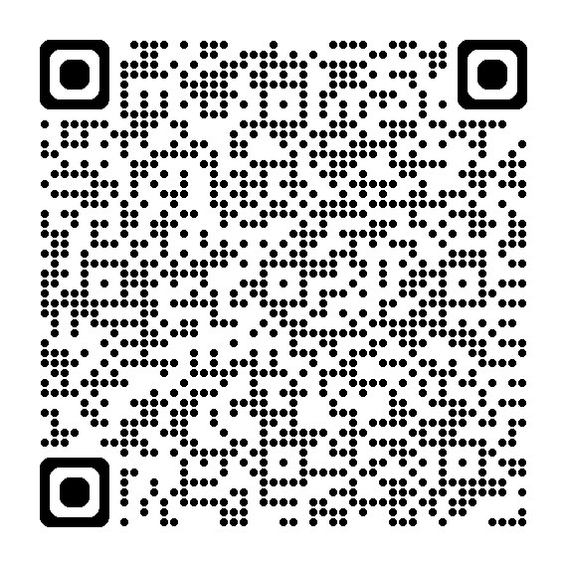
Check back for this page for a downloadable flyer and survey QR code beginning on 6/9.
Notes:
Survey information webpage will be available.

Slide 8
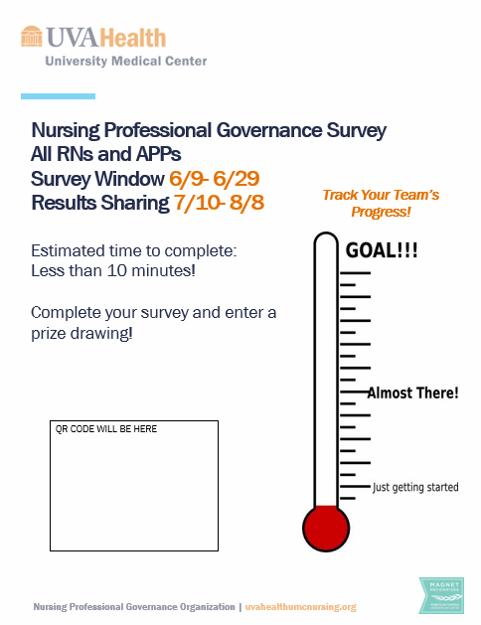
Participation flyer will be available for download on 6/9. Please print and post!

Slide 9
Goal: 51% response rate

